Slide 1
Changing Pain Pathways: Practical Strategies for Pain Education and Treatment
Ontario Physiotherapy Association
2018 Interaction Conference
Notes:
Introduce selves

Slide 2
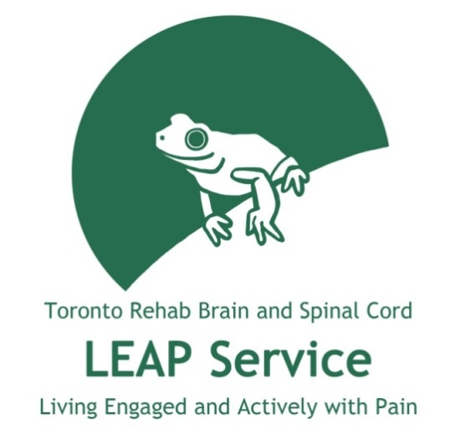
Presenters:
Bonnie Cai-Duarte, BScPT, MSc, PT
Sarah Sheffe, BA, MScOT, OT Reg. (Ont.)
Our Team:
Cara Kircher - OT
Bronwen Moore - OT
Notes:
Briefly introduce ourselves

Slide 3
Their stories
“I realized that my life could go on, despite the pain. I learned that it was not all “outside my control”. I learned that I had the power to change the way I thought about pain and reacted to pain. …Although I can’t always make the pain go away, there are things I can do to make it better, to make it easier for myself.”
- LEAP Client
Notes:
This is why addressing pain and teaching self-management is so important

Slide 4
Teaching pain science
Objectives
Practical strategies for adapting movement and activity
Managing stress, fear, and movement avoidance
Notes:
1) teaching patients about pain science in an understandable way;
2) incorporating stress management, breathing and relaxation techniques around fear and avoidance of movement
3) adapting movement and activity through pacing principles, therapeutic approach and other practical strategies.

Slide 5
Acute vs persistent pain
Acute pain
Temporary
Caused by a specific injury or condition
Persistent pain
Lasts longer than the expected period of healing, or more than 3 months
Notes:
Different disease processes, but note that the transition to persistent pain is on a continuum

Slide 6
Nociceptive pain
The most common type of pain
Caused by nociceptors around the body detecting harmful or potentially harmful changes
Nociceptors: danger sensors at the end of neurons that respond to mechanical, temperature, and chemical changes
Provides useful information
Notes:
Start with a few definitions
Nociception itself is not pain!
MSK pain

Slide 7
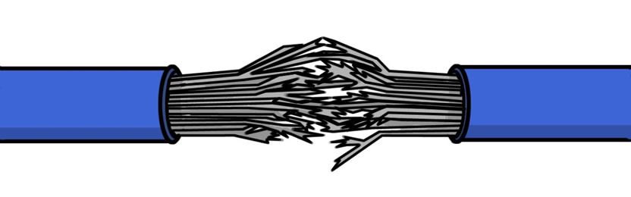
Neuropathic pain
Pain arising from the nervous system due to nerve damage, injury, or infection
Tingling, electrical, burning
Hyperalgesia: heightened pain sensitivity to things that normally cause pain
Allodynia: pain that comes from things that didn’t hurt in the past, such as light touch
Notes:
All pain can start to have a neuropathic element if it lasts long enough – the nervous system changes.

Slide 8
Central Sensitization
“The prolonged but reversible increase in the excitability and synaptic efficacy of neurons in central nociceptive pathways.”
Pain hypersensitivity
Secondary changes in brain activity
Can be present in the absence of inflammation or a neural lesion
Notes:
in addition to producing pain hypersensitivity, results in secondary changes in brain activity
central sensitization represents
an uncoupling of the clear stimulus response relationship that defines nociceptive pain.
prolonged but reversible increase
in the excitability and synaptic efficacy of neurons
in central nociceptive pathways” that
manifests as allodynia (touch-evoked pain),
hyperalgesia (pain experience that is exaggerated
with respect to a standardized noxious
stimulus), enhanced temporal summation
(escalating pain in response to repeated
application of a constant stimulus), and secondary
hyperalgesia (pain and hypersensitivity
beyond the dermatome of the nerve
injury).22

Slide 9
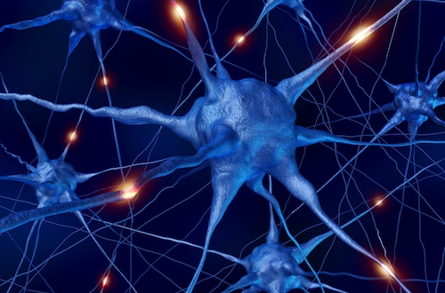
Pain 101
Notes:
This next section is a review of pain physiology for all you physios but also gives some ideas of how we actually teach pain physiology to our patients. You can adjust these next few slides to adapt it to the setting you in either breaking it down to 10 minute sections or teach it in a 1 hour segment.
“Pain is a multidimensional experience produced by characteristic neurosignature patterns of nerve impulses in the brain”
Ronald Melzack
Both a sensory and emotional experience (IASP)

Slide 10
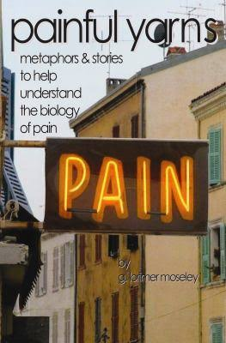
Teaching concepts for self-management
Ask questions
Use metaphors and analogies
Provide visuals
Notes:
Will give you many of the metaphors we use with clients to help explain complex concepts
Aids memory, retention, engagement with content

Slide 11


Pain protects us from harm
Be careful! You are close to injury!
Stop! You have damaged the body!
Notes:
Pain can feel like the enemy that stops you from doing exercises or activities. Rightly so, but pain has a purpose.
What is the purpose of pain? Exists for a good reason

Slide 12
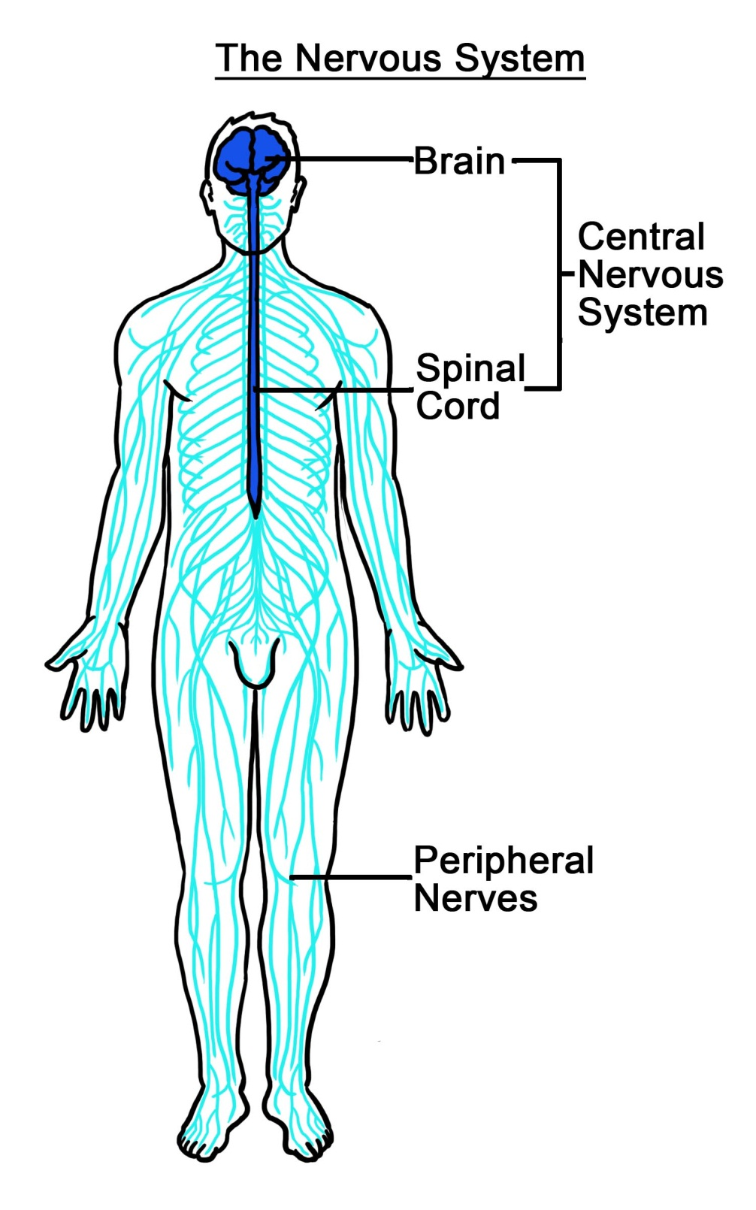
All pain is experienced in the nervous system
Notes:
Streets metaphor

Slide 13
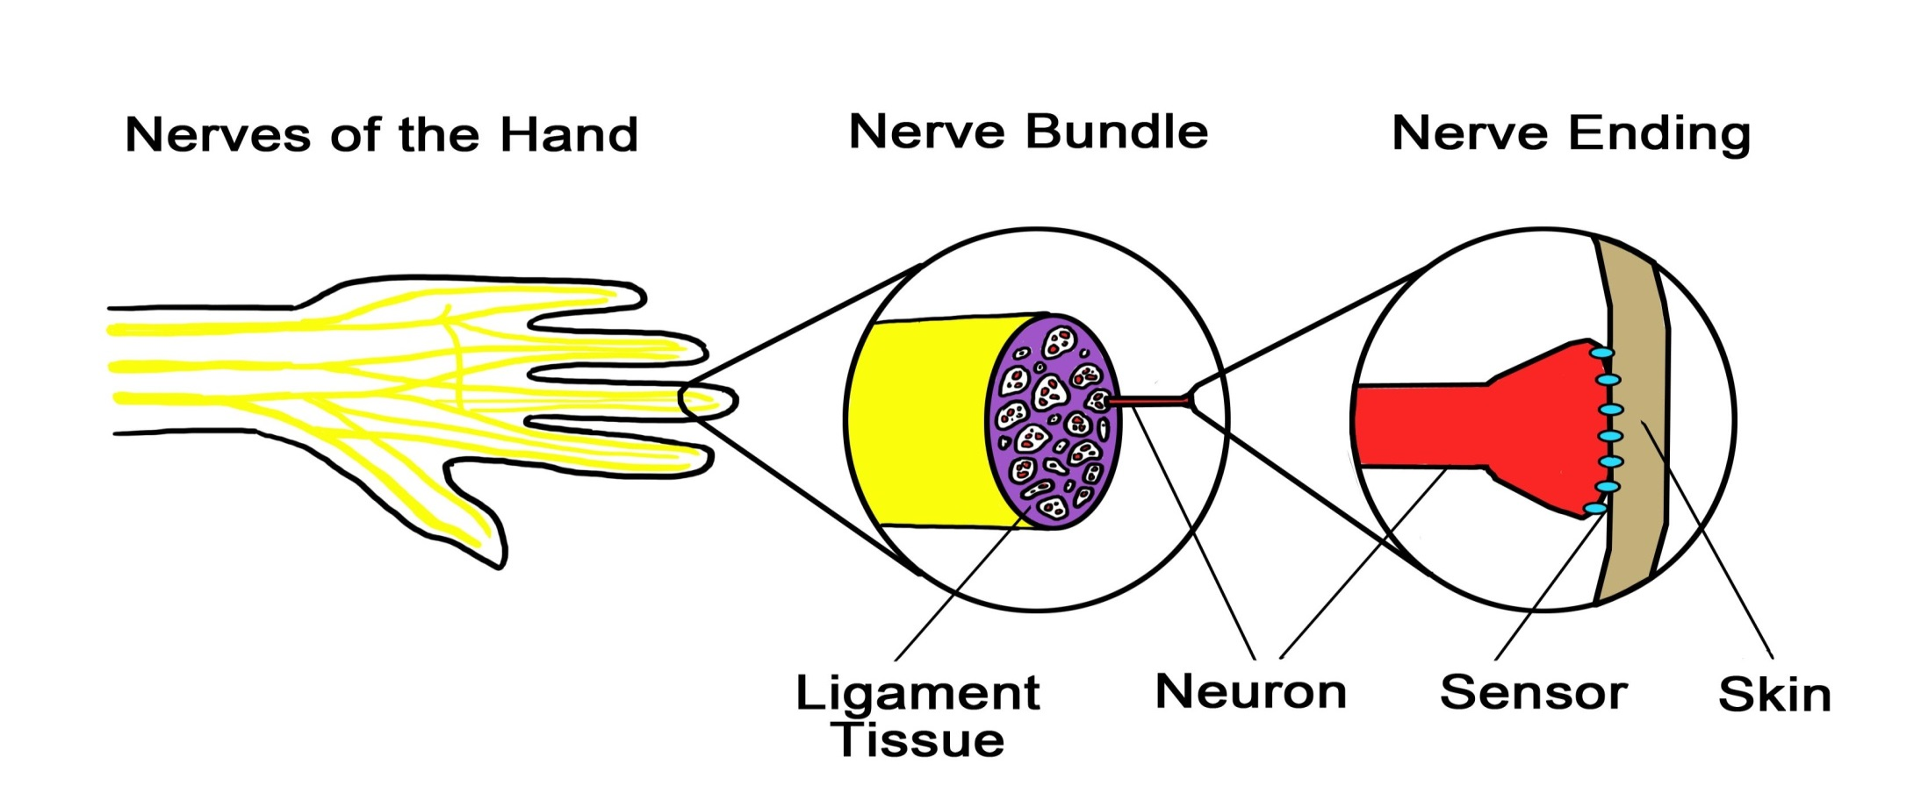
Peripheral nerves
Redness
Heat
Swelling
DANGER
Notes:
Peripheral nerves [side streets]
The peripheral nervous system is made up of many cord-like nerves that travel all through the body.
Nerves are made up of individual neurons. The feeling of pain begins first as a “danger message” sent to our brain by these neurons. These neurons have tiny “sensors” which pick up changes in:
Temperature: hot or cold
Mechanical force: pinch or pressure
Chemistry: changes to chemicals within cells
An electrical current is generated and peripheral nerves send electrical impulses to the spinal cord.

Slide 14
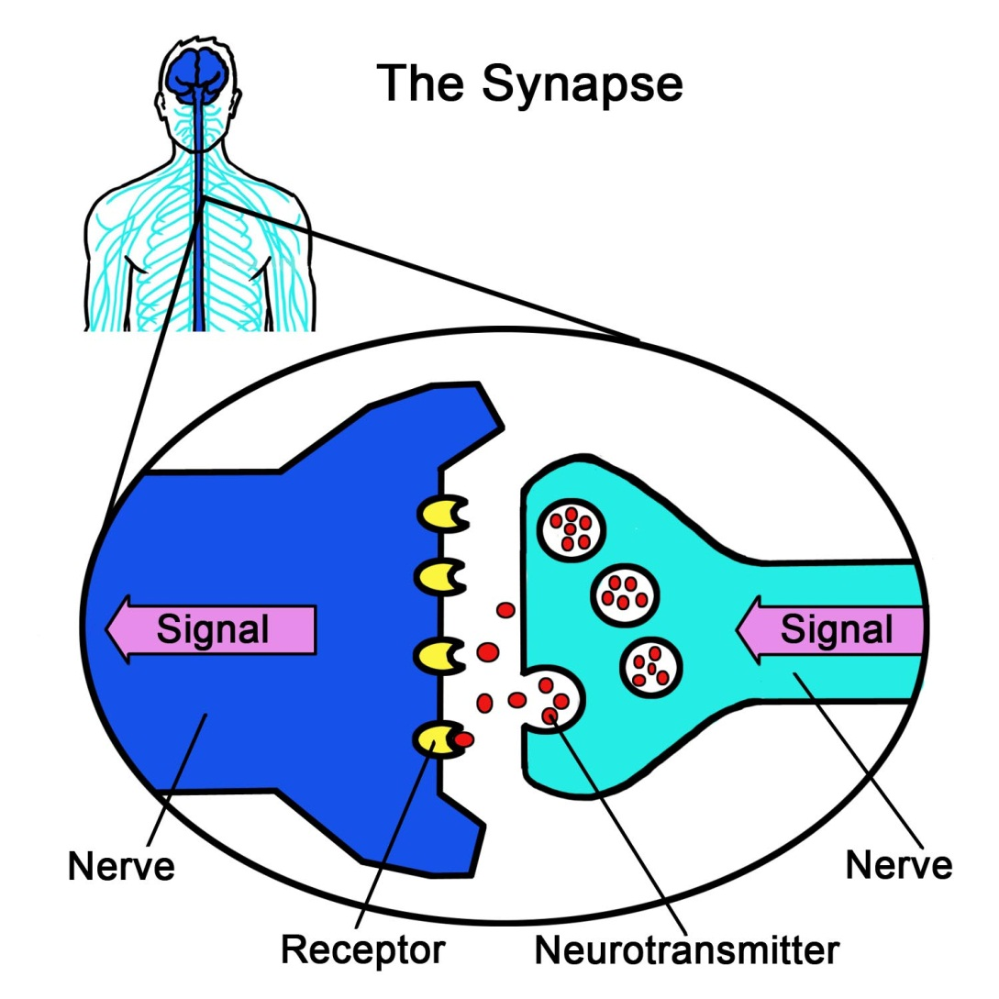

Spinal cord
Notes:
Spinal Cord [highway]
There is a space (synapse) where the peripheral neuron ends and the spinal cord neurons begin.
In the space between neurons, the signal changes from an electrical signal to a chemical signal. The peripheral neuron releases small packets of chemicals that tell the spinal cord neurons what to do.
With nociception, these chemicals are telling the spinal neurons to get excited and send this message by electrical signal up to the brain.
As long as there are enough chemical packets, the message will get through to the spinal neurons
If there are not enough then the spinal cord will not send the danger message along.

Slide 15
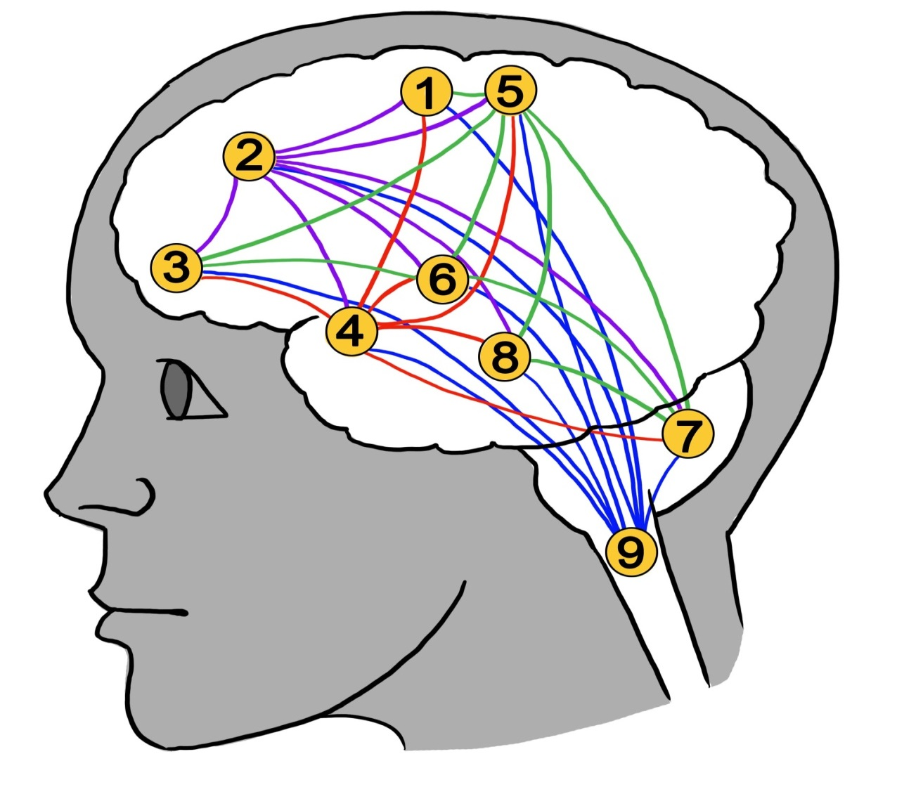

Brain
Notes:
Brain [downtown core]
It is the brain’s job to process all the sensory information that is arriving from the spinal cord.
The message sent up the spinal cord actually travels to many areas in the brain
Every pain experience is unique and so each one of us will have a different experience when danger messages are processed by the brain.

Slide 16

Brain
Cingulate cortex: | concentration, focusing
Pre/motor cortex: | organize & prepare movements
Sensory cortex: | identifies what body parts are affected
Hypo/thalamus: | stress response, autonomic regulation
Prefrontal cortex: | problem solving, memory
Cerebellum: | movement and cognition
Amygdala: | fear, anxiety, anticipation
Hippocampus: | memory
PAIN EXPERIENCE
Notes:
Shorter!!
Important to note that the pain experience can include moderating/down regulating factors as well – remember, the nervous system is all two way streets.
For example, mood can moderate pain – people feel less pain intensity when in positive moods.
Example: getting a tattoo is painful but there is a down-regulation of the nervous system because the sensations of tattooing are an expected part of an overall positive and desired experience

Slide 17
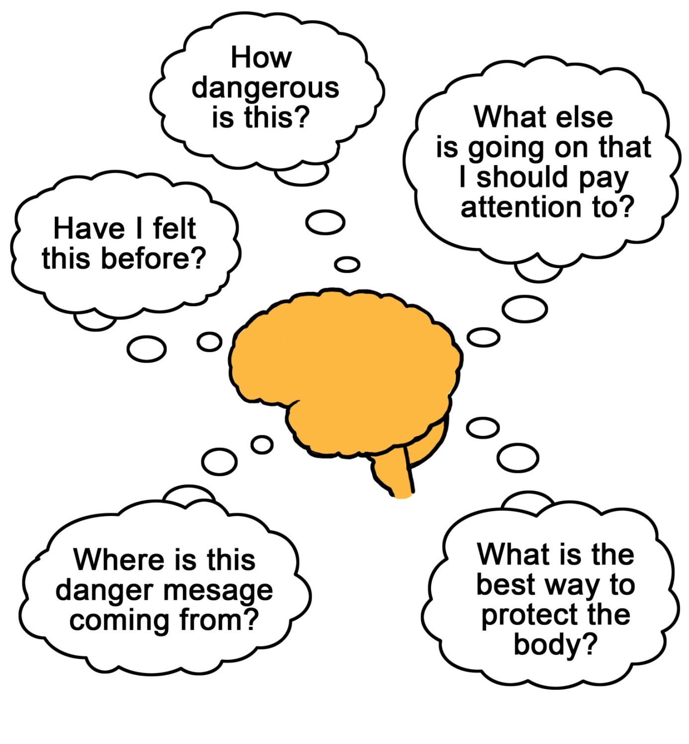
Notes:
Part of the output of the brain

Slide 18
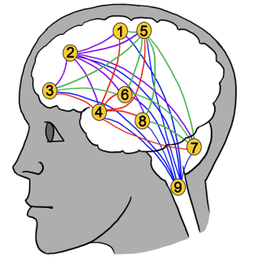

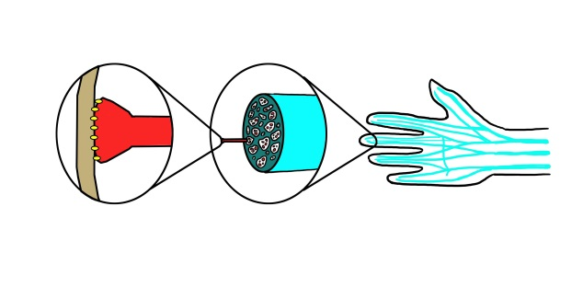
Pain basics: Nociception
Nociceptors pick up changes in temperature, mechanical force, or chemistry
Spinal neurons become excited and send message along spinal cord to brain
Sensory information arriving from the spinal cord is processed in hundreds of areas
Brain
Spinal cord
Peripheral nerves
Spinal cord neuron
Nociceptor
Glutamate
Notes:
Overview of Nociception
In order to feel pain, the 3 parts of the nervous system work together
Nociception is the neural process of encoding noxious stimuli. Nociception does not necessarily imply pain sensation.
Nociceptive pain is used to guard against tissue injury and direct attention towards potentially damaging stimuli.

Slide 19
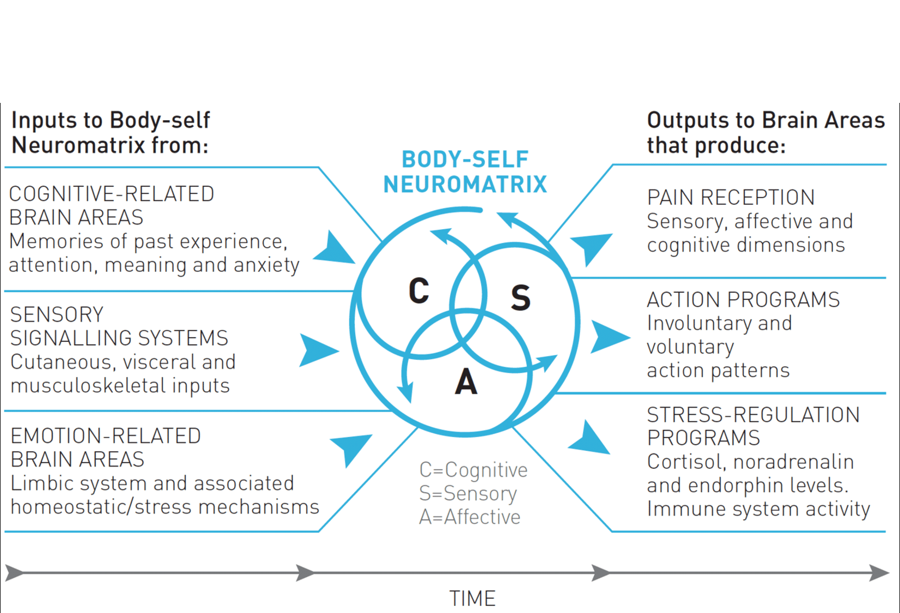
The Neuromatrix theory proposed by Ronald Melzack in 1996

Slide 20

The orchestra of pain
Notes:
We can think of the neuromatrix like a “pain orchestra”

Slide 21
Why do I still hurt?
Notes:
A common question clients have, particularly when pain lasts beyond visible injury. Being able to educate clients about this question can improve treatment outcomes by decreasing fear-avoidance

Slide 22
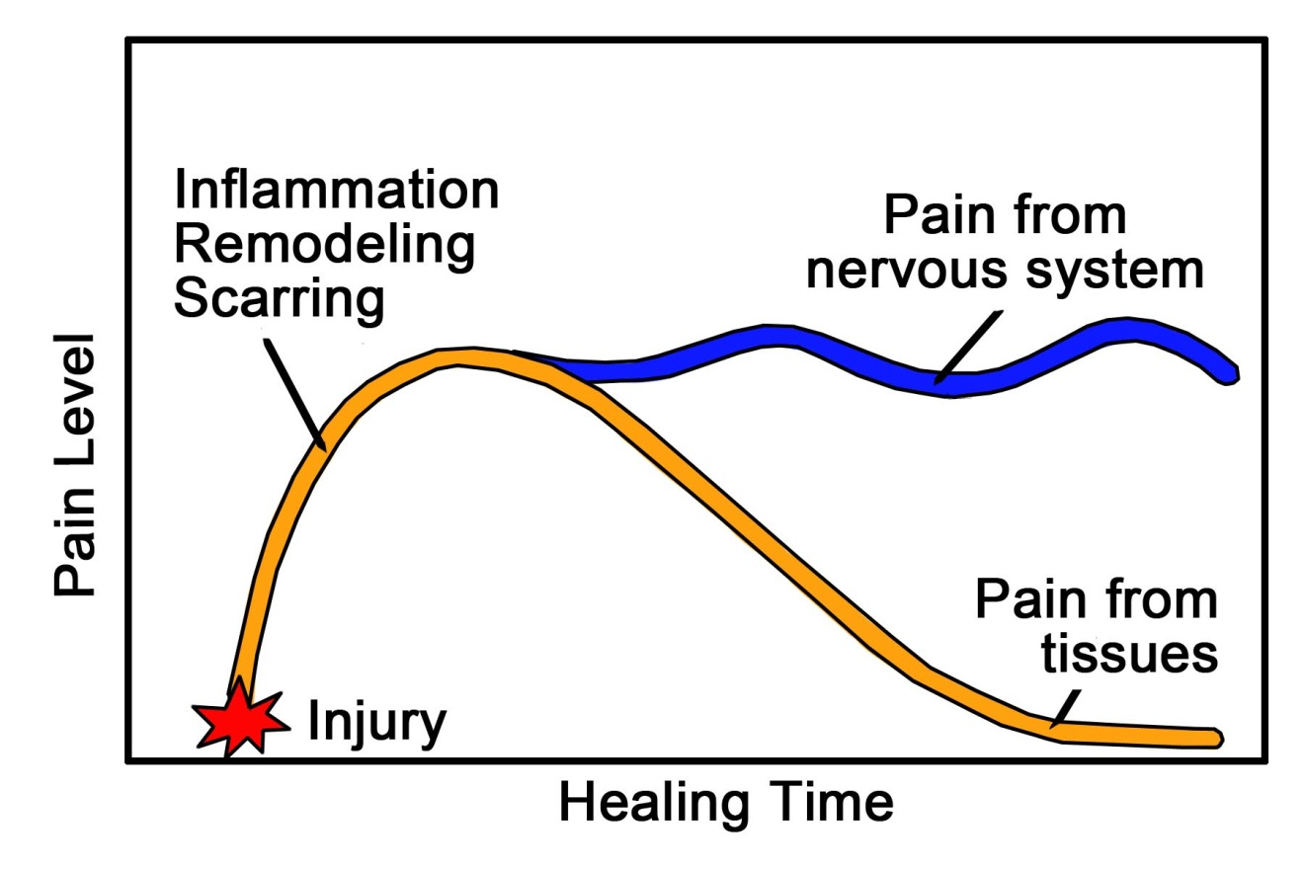
Pain can go on, even long after the body has healed
(Butler & Moseley, 2014)
Notes:
Neuropathic pain can persist long after the tissues have healed because there is damage to the nerves of the peripheral or central NS

Slide 23
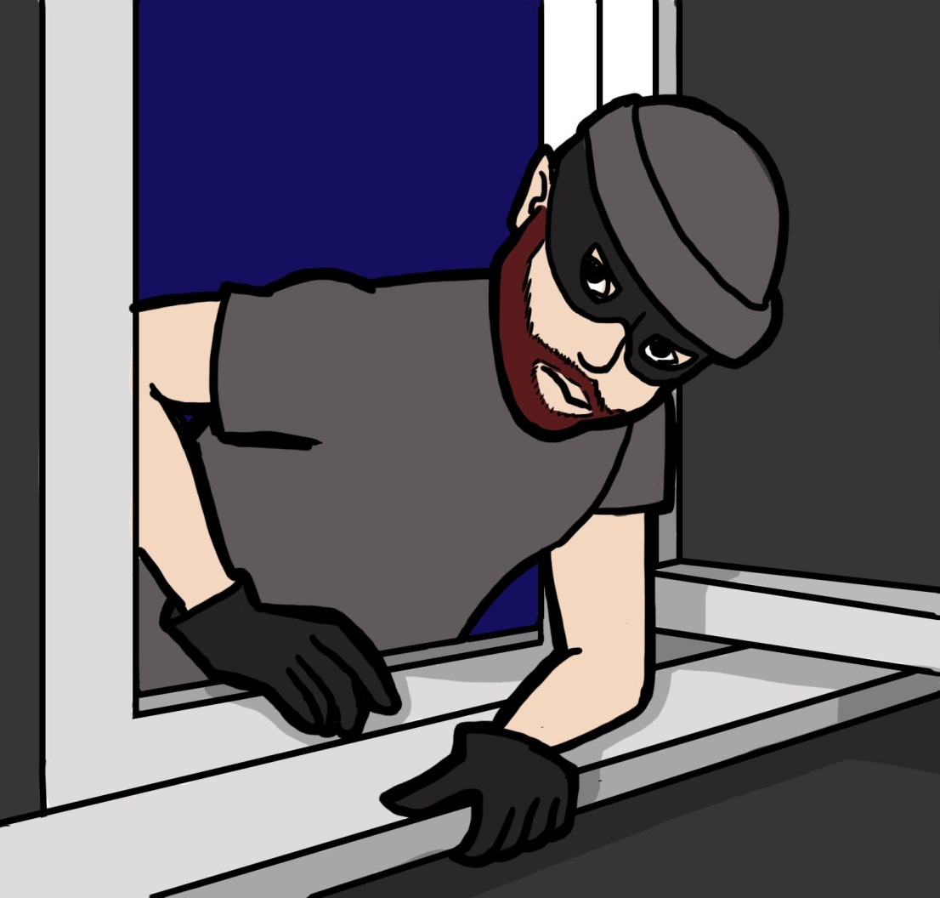
When pain persists, the nervous system can become sensitized
Notes:
Burglar analogy for central sensitization

Slide 24
How does the nervous system get sensitized?
Inflammation
Chemistry
Brain pathways
Spinal cord neurons
Notes:
Inflammatory pain arises from increased sensory sensitivity after tissue damage. Unlike nociceptive pain which acts to protect the body against a damaging noxious stimulus, inflammatory pain aids in healing and repair of tissue following damage. Inflammatory pain helps make the injured body part more sensitive in order to reduce usage of that body part, thus avoiding re-injury and promoting recovery. Following injury, heightened sensitivity occurs within the inflamed area and in nearby non-inflamed areas as a result of sensitization in the plasticity in noxious stimulus-detecting sensory system.
Chemistry: Peripheral sensitization is an increased sensitivity to stimulus following injury or cell damage to the area. It produces a 'flare response' due to nocioceptors producing neuropeptides. This results in an increased sensitivity to heat and touch stimuli.
Spinal cord neurons: Long term potentiation (dorsal horn “wind up” in spinal cord)
Brain pathways: neuroplasticity in the brain

Slide 25
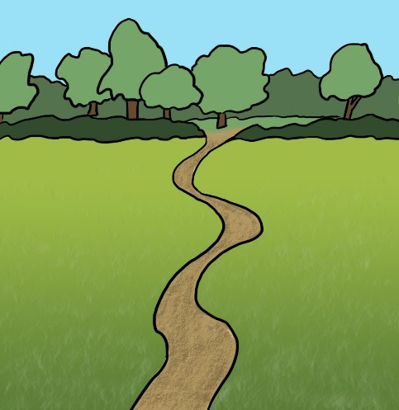
Neuroplasticity and pain
The brain changes in order to adapt to changing environments
These adaptations are designed to be helpful in the short term, but can lead to persistent pain states in the long term
Notes:
Wearing down pathways
Nerves that fire together, wire together
The brain tries to protect the body from future dangers by changing pathways that regulate emotions, memory, movement etc.

Slide 26
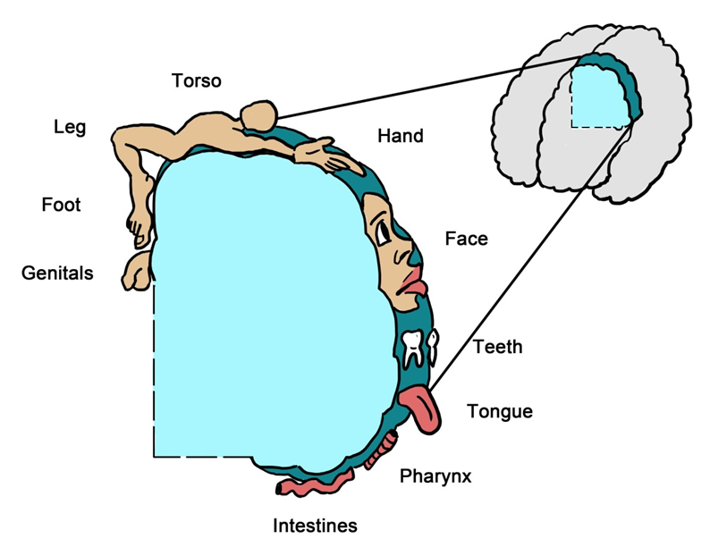
Pain in the “virtual body”
Notes:
Areas of the brain that are damaged may process information differently
Long-term neuropathic pain in humans can have widespread effects on brain anatomy that is correlated to the duration and magnitude of pain. Morphological alterations in the brain, mostly representing local decreases in brain gray matter, have been observed in people with chronic back pain, irritable bowel syndrome, fibromyalgia, headaches, and other chronic pain conditions.
It is difficult to interpret how changes in brain morphology may relate to chronic pain – it is important to discern whether these changes are the cause or the consequence of pain. It is also notable that other neural and cognitive disorders, such as depression, are also accompanied by changes in brain volume. Yet, the changes in chronic pain across different pain syndromes appear to involve alterations in areas largely associated with affective processing of pain. Furthermore, the decrease in gray matter associated with chronic pain is at least partially reversible when pain is successfully treated, suggesting that these structural changes are a reversible consequence of frequent nociceptive inputs. (U of T Pain Mechanisms module)

Slide 27
Fear conditioning
Pavlovian model of classical conditioning
Persistent pain changes brain circuitry related to learning (hippocampus, amygdala and prefrontal cortex)
When a pain experience is paired often enough with a previously neutral stimulus (e.g. movement)
Nerves that fire together, wire together
(Abdallah & Geha, 2017)
Notes:
Teach that pain=/= damage/harm
Hurt is not harm!

Slide 28
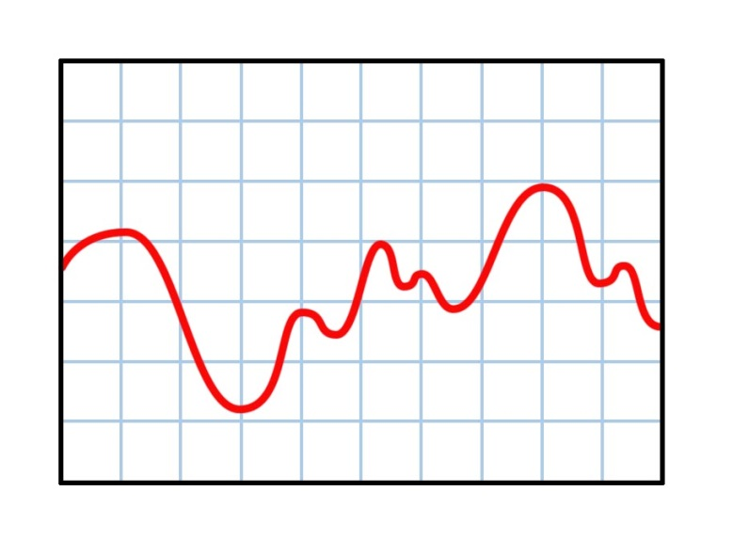
Will this pain go away?
It is very difficult to predict… and this is very frustrating!
Many people still have “ups and downs” even if things are generally getting better
Pain flare-ups are unpleasant, but normal
Notes:
Normalizing client experiences can also serve to decrease fear or worry about their pain. Feeling like they’re experiencing major setbacks in pain experience can be very demoralizing and demotivating, so when clients understand that these “setbacks” are not permanent, they can feel reassured and research shows they will get back to their usual routines or therapies more quickly

Slide 29
Always ask about pain
It’s okay not to have all the answers
Acknowledge, validate and be curious
Ask about patterns: “What makes the pain even a little bit better? What makes it worse? What do you do when pain arises?”
Find out if pain is new or longstanding

Slide 30
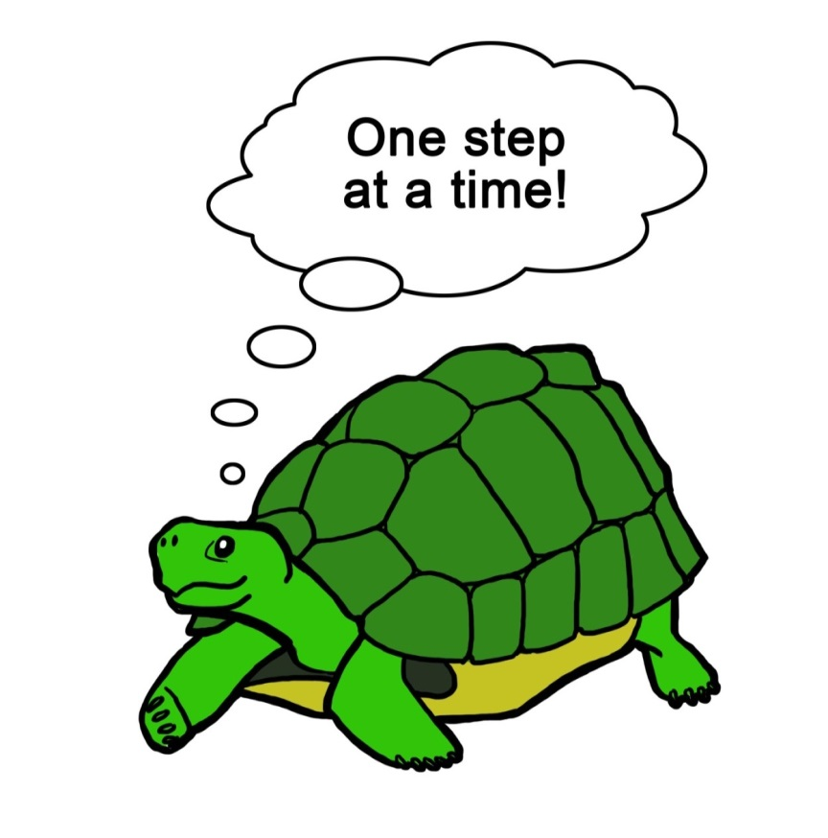
Practice, practice, practice!
Neuroplastic changes take time (weeks)
Encourage clients to stick with strategies
Approach with low expectations and lots of curiosity
Reward small steps forward

Slide 31
1. Pain Education

Slide 32
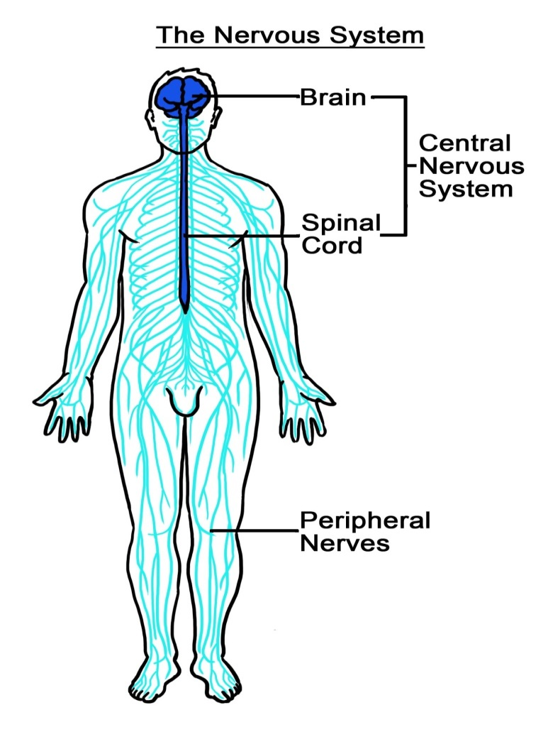
Help clients to learn about how pain works (pain education)
Decreases fear
Increases function
See Resources
(Moseley, Nicholas, & Hodges, 2004)
Notes:
If you are comfortable going through pain education with clients, do so, if not, use the resources below to show videos and start the discussion.

Slide 33
2. Movement and exercise

Slide 34
Pain patterns
When teaching exercises, which pattern do we encourage:
  Avoid the pain
    Advice from healthcare providers to limit activity is a risk factor for persistent pain
    If you must set limits, revisit and tell client when limits can be lifted
  The “yo-yo”
    Overdoing it, then resting for long periods
(Wittmer, Stannos,
Bertoch,& Gaffron, 2014)
Notes:
We all know the benefits of exercise and movement for pain management yet it is often of the most difficult strategies to implement with clients with pain….
Avoid the pain:
It hurts so don’t go there…..
Encourage gentle movement whenever possible; move any part that does not hurt.
We know there are times to implement restrictions on movement i.e. fractures or tears, but more often than not, they won’t likely go into painful movement. It’s better to educate them and encourage them to move within their tolerance levels.
The yo-yo is what we commonly see in clients struggling with pain…

Slide 35
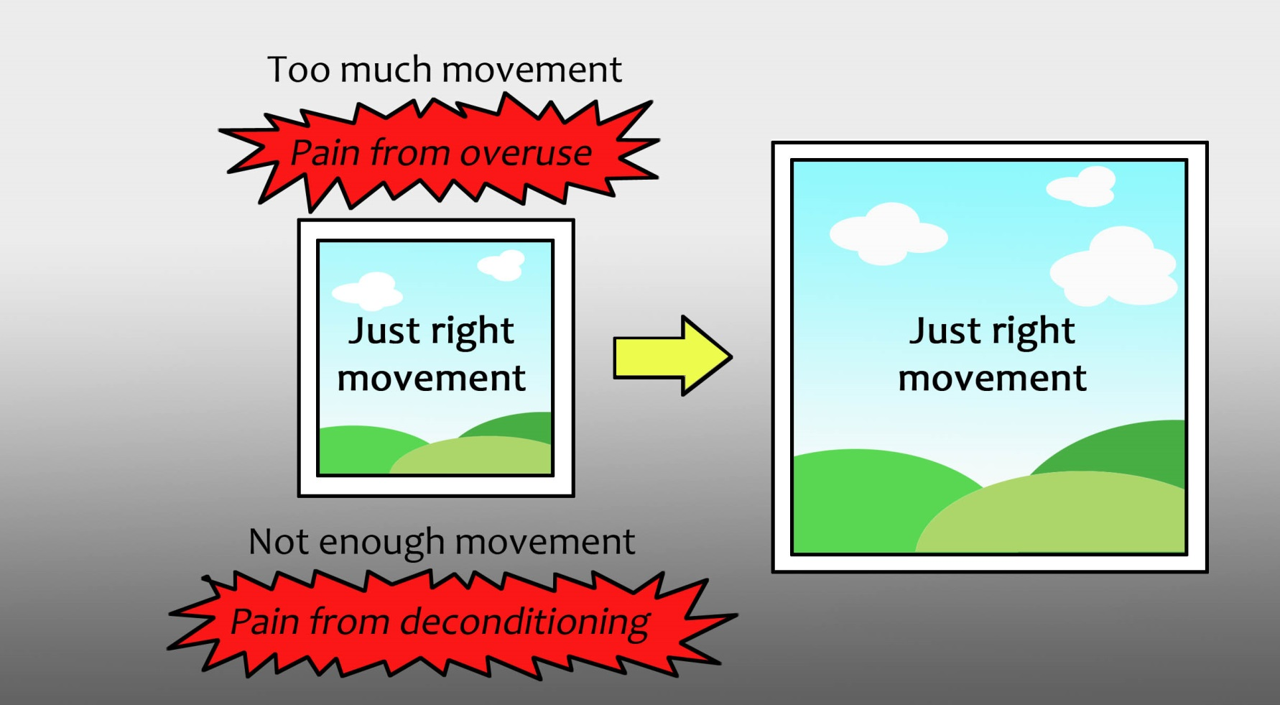
The therapeutic window
(Jones & Hoffman, 2006)

Slide 36
Tips for finding the therapeutic window
Trust that clients know their bodies best…
Teaching clients to adjust the activity:
  FITT principle
Teach them to be calm when faced with pain during movement and ask:
  Will I regret this tomorrow?
  Is this really dangerous?
(Pain Care Yoga – Neil Pearson)

Slide 37
Other ideas to keep in mind…
Stick to the 10% rule & track progress
Visualize Movement and move parts that don’t hurt
Focus on Cardiovascular endurance
Troubleshooting barriers and solutions…THINK DIFFERENTLY Persistent pain takes much longer
(Marcus & Forsyth, 2009; Swank, 2013)

Slide 38
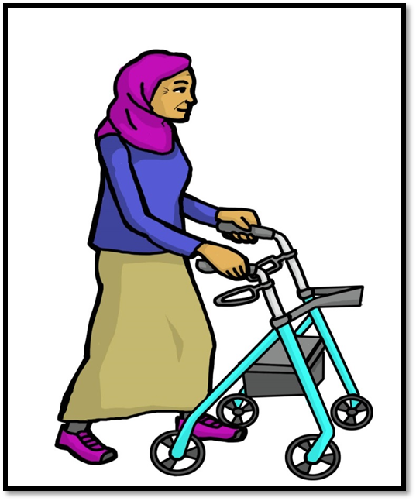
Other ideas continued….
Be creative and experiment to find new ways to doing activities
Pacing to ease gradually back into activities
Set small goals, make a plan and track your progress
Using slow and mindful movement such as yoga and tai chi
Notes:
Challenge the pain with gentle activity
It is very common to be afraid of movement when you have pain. After all, pain is often a warning meant to stop us from moving so you avoid injury. You may have been told at some point in your recovery to stop or limit certain movements. When pain is present, sometimes resting the body is helpful as tissues recover. But in the long term, once tissues have been healed, movement is better than rest at reducing pain.
• Try doing activities that are new and enjoyable. Research shows that moving in new ways can be helpful to interrupt the “pain orchestra” in the brain.
• Pay attention to how you are moving. Slow down movements at first and take your time. Breathe in and out as you move. Make sure you are moving in ways that are safe, but allow some discomfort or pain to be there. Stay calm and focused.
• Pace yourself as you ease gradually back into activities.
• Be creative and experiment to find new ways to connect with the things and people that matter most to you. Test out your assumptions about what will happen if you do things differently than you used to.
• Set small goals, make a plan and track your progress. There are some ideas in the introduction section of this workbook to help get you started.

Slide 39
3. Stress Management and Relaxation
Notes:
Discussion and obtain staff understanding of what stress is.

Slide 40
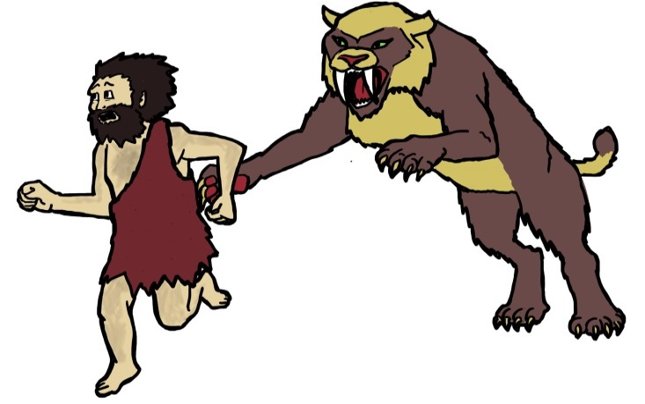
Stress is…
A normal part of life often triggered by change
A powerful automatic reaction
A part of our survival system
Notes:
• A normal part of daily life.
• A healthy part of our survival system.
• Turned on by a feeling that you are in danger.
• A strong and powerful reaction. (It is stronger for some people than others due to our genes.)
Pain is stressful! It can…
Turn on the body’s stress response because it (pain) feels like a threat.
Make the brain more sensitive to stress: brain gets repeated pain & stress signals, adapts to be more alert to them
Stress is painful! It can…
Make your muscles tense up, which can make the pain worse.
Change body chemistry. This can make you more prone to inflammation. It can also take away pain relieving chemicals like endorphin and serotonin.
Be felt as physical pain. The pain and stress systems are both “survival systems” that help people to live through danger. Because the pain and stress systems work together so often, the brain can get them mixed up and can react to them in the same way.

Slide 41
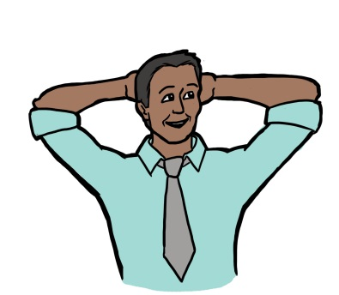
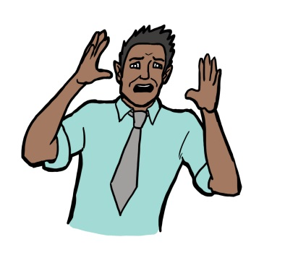
Fight / Flight / Freeze
Rest and Digest
Breathing rate
Heart rate
Blood pressure
Muscle tension
Blood sugar
Cholesterol
Metabolism
Adrenaline
Senses
Thought process
Creativity
Sex hormones
Digestive system
Immune system
Notes:
The sympathetic nervous system prepares the body for intense physical activity and is often referred to as the fight-or-flight response.
Theparasympathetic nervous system has almost the exact opposite effect and relaxes the body and inhibits or slows many high energy functions.

Slide 42
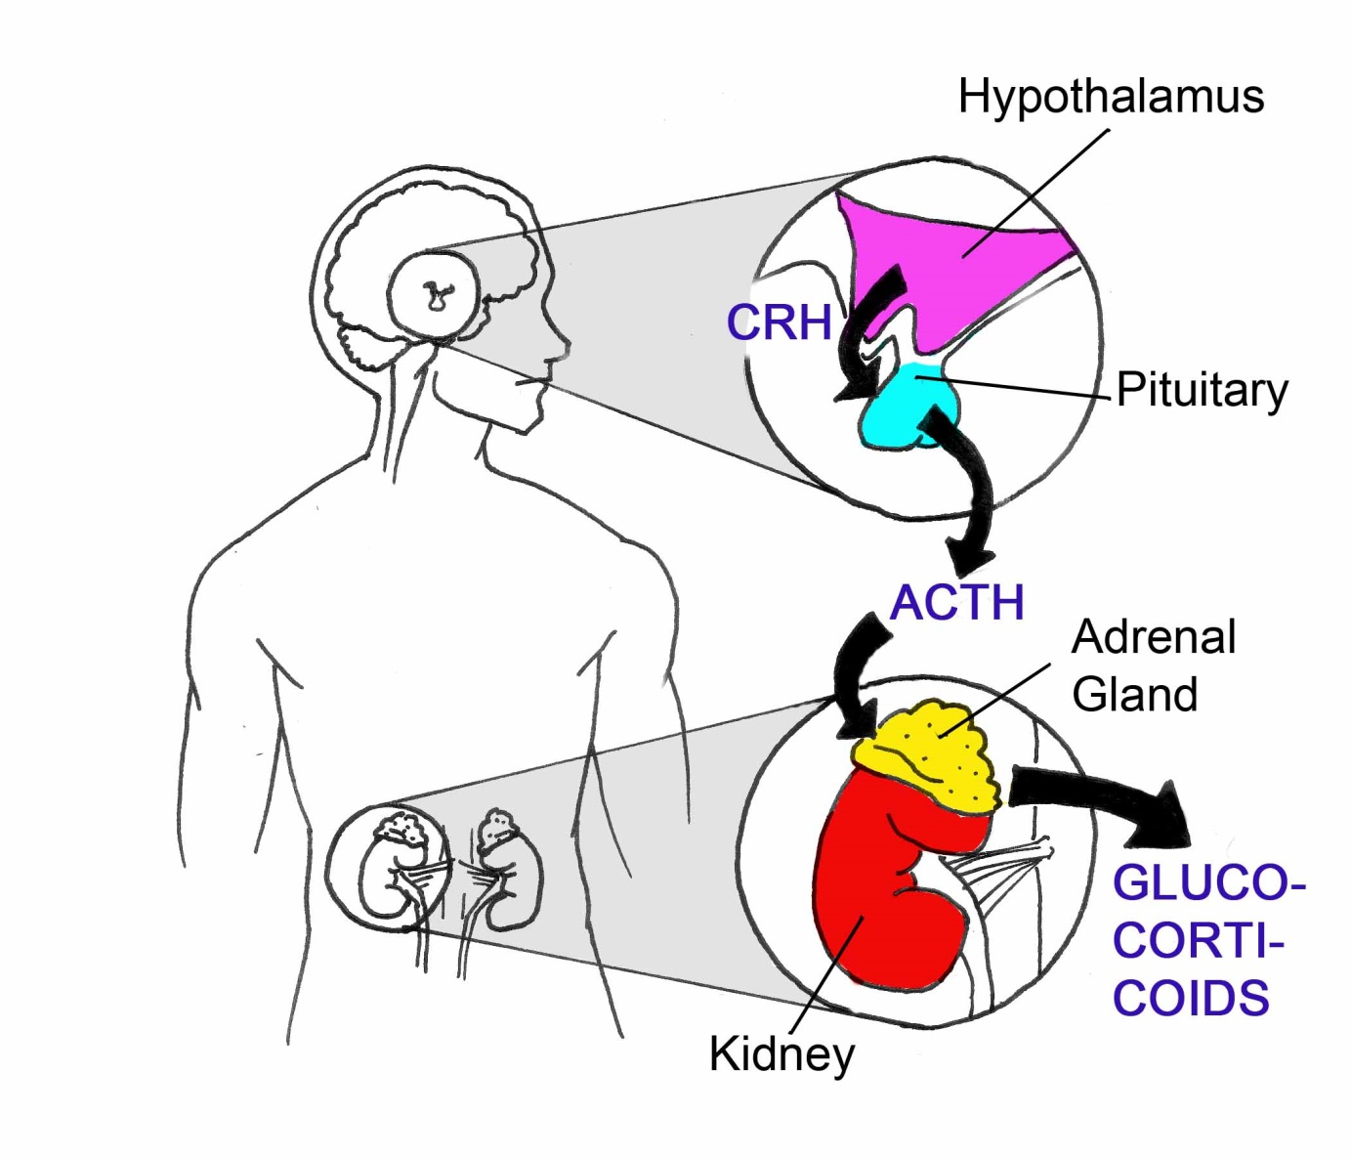
Hypothalamus Pituitary Adrenal Axis
(Hass-Cohen & Findlay, 2009)
(Bronwen Moore, 2012)
Notes:
HPA axis:
Chronic and unremitting pain may result in a loss of control and helplessness,
activating the hypothalamic–pituitary–adrenal (HPA) axis. – Sympathetic nervous system
an attempt to conserve resources and survive the pain.
The HPA response results in the release of cortisol.
- its unremitting release negatively impacts long-term health (Hass-Cohen & Findlay, 2009)

Slide 43
Stress chemicals
Chemical | Function | Area of production
Corticotropin-releasing hormone (CRH) | Stimulates HPA axis | Released by hypothalamus → stimulates pituitary
Adrenocorticotropic hormone (ACTH) | Activates adrenal gland | Released by pituitary → activates adrenal gland
Epinephrine / Adrenaline | Activates sympathetic nervous system | Produced by adrenal glands
Norepinephrine | Regulates heart and blood flow | Neurotransmitters produced by all sympathetic nerve endings
Glucagon | Raises blood glucose levels | Hormones produced by pancreas
Glucocorticoids / Cortisol | Regulates cardiovascular, metabolic and immune systems | Hormones produced by adrenal glands
        (Melzack, & Lariviere, 2000)

Slide 44
When is the stress response activated?
When we feel in danger or in pain
When there are changes in our lives
  Stress = change/control
When we think about past/future stressful events

Slide 45
When is stress helpful?
Stress response works best for short-term threats
Stress is helpful when we feel we have:
  Control
  Skills required to meet the challenge
Short-term stress can decrease pain
    Stress-induced analgesia caused by adrenalin, and endorphin surge

Slide 46
When is stress harmful?
Stress response that is on for too long, or too strong can damage the body
  HPA axis causes release of inflammatory chemicals such as cortisol
  Heart disease, stroke, diabetes, chronic pain, anxiety, depression, all linked with stress response
  Body can become hyper-reactive to pain (stress-induced hyperalgesia)

Slide 47
Stress and pain
Persistent pain can feel like an inescapable stressor
  Loss of control and perceived helplessness can activate HPA axis
Pain is stressful!
Stress is painful!
(Sapolsky, 2004)
Notes:
Staff education. Background information.
Stress-induced analgesia
Short term stress response can produce increased endorphins to dampen pain:
Ex. Injured soldiers, runner’s high
Stress-induced hyperalgesia
With prolonged stress, endorphin levels can become depleted
Emotional centres in brain can become hyperactive to pain
Over time, the stress response can become damaging to the body
Chronic pain acts as an inescapable psychological stressor, whereas the stress response is better designed for “fight or flight” reactions

Slide 48
How can I best manage my stress?

Slide 49


1. Know warning signs of stress
It is easier to deal with a small stress response than a big one
Vs.
Notes:
Warning signs of stress
Physical changes
Headache
Muscle tension
Behavioural changes
Becoming quiet or quick to anger
Rushing around
Thoughts and emotional changes
Feeling trapped, overwhelmed, upset
Racing thoughts

Slide 50
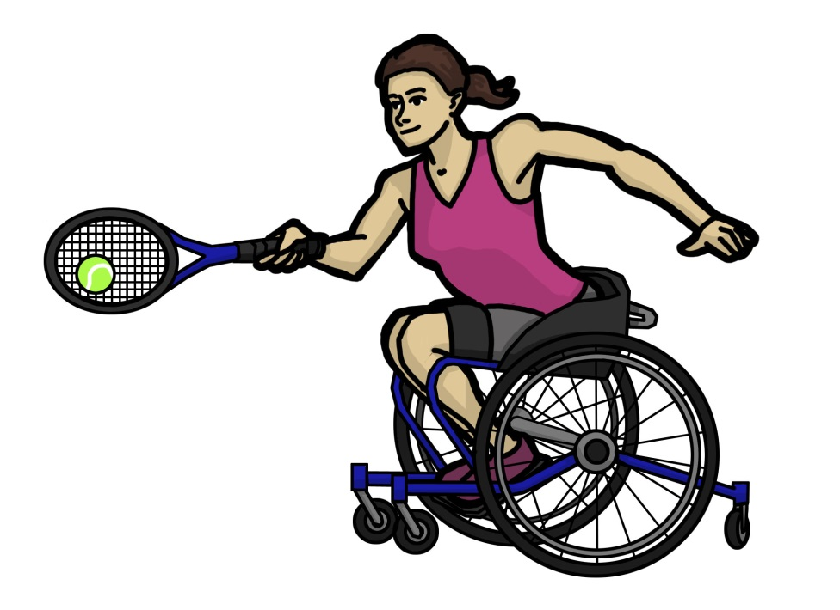
2. Movement
Do enjoyable movement
For best results, move daily (benefits last 24 hours)
        (Davis, Eschelman and McKay, 2008)

Slide 51
3. Find ways to take control
Ask yourself:
  “What can I do about this?”
  “Is this really my problem?”
If there is something you can do, make a plan to do it
Set small, realistic goals
Take baby steps
        (Davis, Eschelman and McKay, 2008)

Slide 52
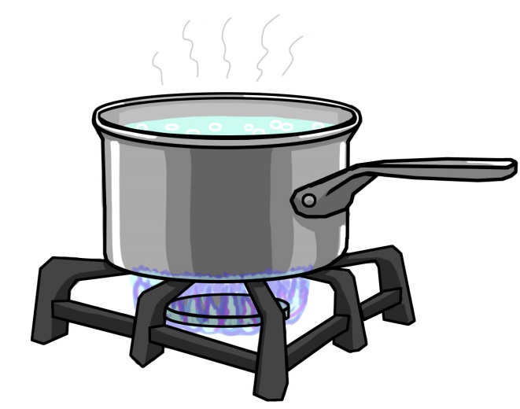
4. Relax regularly
Plan relaxing activities often:
  Hobbies
  Listen to music
  Get out into nature
  Spend time with support people
These things may feel like a luxury, but they are necessary to keep you resilient
Notes:
Boiling water metaphor

Slide 53
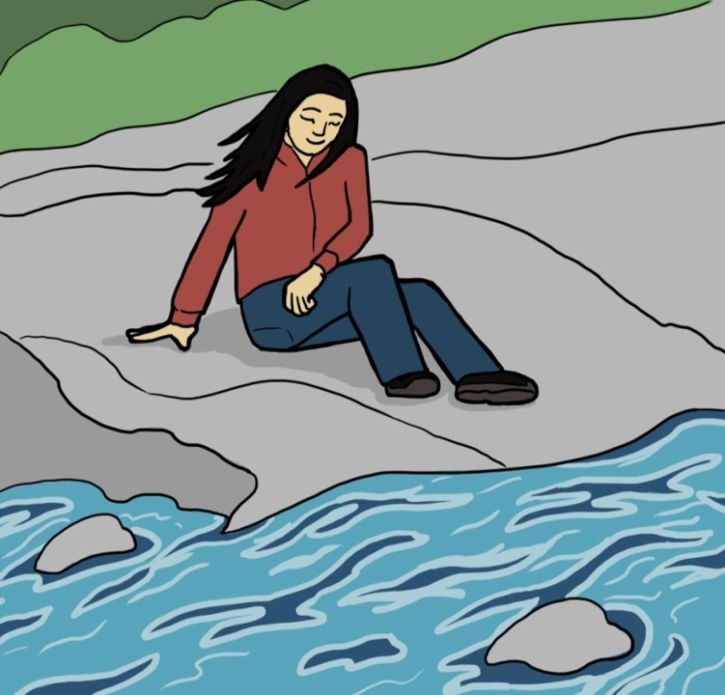
Relaxation Techniques
Relaxation “over-rides” your stress response by sending powerful signals to your body that it is safe:
Breathing slowly and deeply
Relaxing muscle tension
Meditation
Coping thoughts
Cultivate willingness and acceptance (vs struggle)
(Sommer & Witkiewicz, 2004;
Iezzi, Duckworth, Mercer, & Vuong, 2007; Tyler & Lievesley, 2003)
Notes:
Calm the mind and body
Strategies to calm the mind and body are valuable because your body always responds to pain as an emergency. This turns on the stress response, which in turn makes it difficult to think of ways to manage the pain. Here are some calming strategies:
• Use relaxation techniques (e.g., deep breathing, body scan, meditation). This can help to reset the nervous system and turn down the alarm.
• Rest (but not too much)- short, frequent rest breaks are best.
• Control your breathing: take slow breaths, and imagine breathing in and out from the painful area.
• Visualize a safe and soothing scene (e.g., a beach, or getting a massage).
• Use coping thoughts (e.g., say to yourself, “This will pass”, “I can do this”).
• Talk to someone supportive (e.g., friend, family member, therapist).

Slide 54

Notes:
Breathing space practice!

Slide 55
4. Pacing

Slide 56
Pacing: staying active, while respecting your limits.
Notes:
According to the Polyvagal Theory, (reference)
In order for the brain to heal, it needs to feel safe
Pacing is finding ways to allow the brain to take breaks from the pain and feel safe
The following are some patterns of that pain clients can fall into as a result of habitual coping

Slide 57
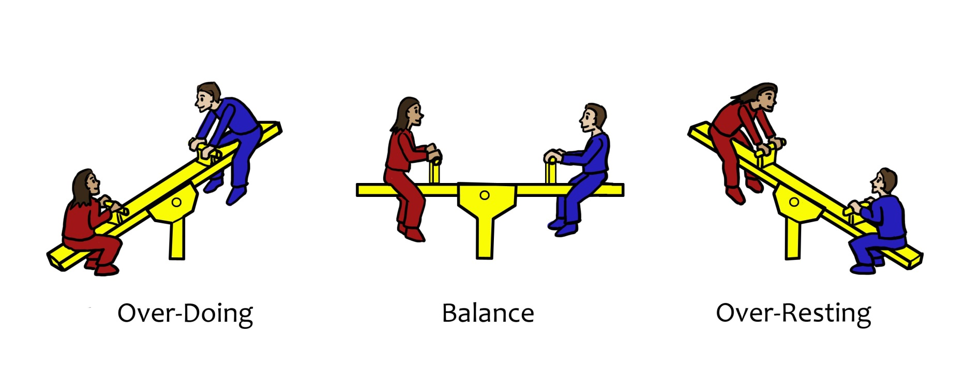


Finding the balance: activity and rest
Balance
See-saw
Doing too much
Resting too much

Slide 58
Pacing for people who over-do, then over-rest (yo-yo)
Create daily and weekly routines that involve planning and spreading out activities
Be conservative with how you plan activities at first and then build up slowly as your tolerance increases
Notes:
For example, there are people who will feel like if they go out for an appointment, they will book all their appointments on one day since they are out already, but the idea is to plan to spread them out.

Slide 59
Finding balance
Discover how much time you can spend doing an activity before pain increases, then learn to stop before that point.
Slowly start increasing time as your body allows.
Learn ways to adapt activities.

Slide 60
Pacing for those who tend to rest too much?
Getting going can be hard especially with low mood or fears of re-injury
Start small: do the first step then see how you feel
  Use a pleasurable activity as a reward for doing an unpleasant activity
Use coping thoughts to talk yourself into getting started
Notes:
This can be the clients who are fearful of movement and planning activities because they’ve had a really bad experience with it. Initiation is really challenging and difficult.

Slide 61
Pacing for those who tend to do too much?
  Get to know the warning signs that you need a break
Use reminders to take breaks and slow down
  Think of rest as an important and productive activity
  Have a list of things you can do while on break so you feel productive while resting

Slide 62
List of Activities to do while resting
Do a relaxation or meditation exercise | Do a gratitude practice (e.g. journal)
Read a news story or book | Take care of plants
Plan the day’s activities | Stretch or move
Listen to music | Eat something you enjoy
Listen to the radio | Light a candle
Spend time with a pet | Review goals
Listen to an audio book | Clean or tidy up a small area
Send a friendly text or email | Play a game (e.g. cards / online game)

Slide 63
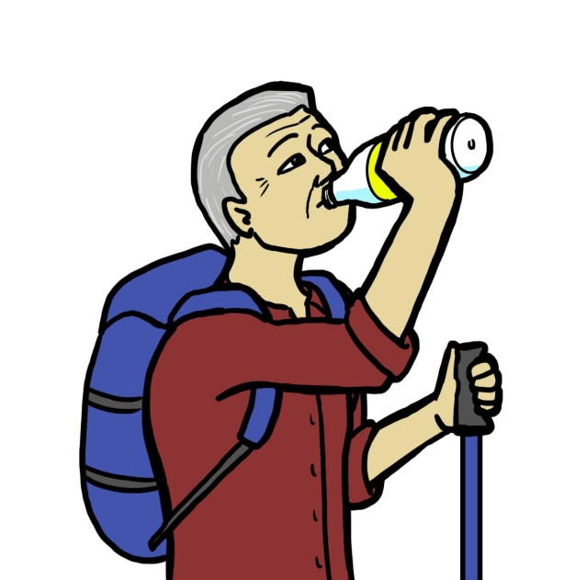
Drink before you get thirsty….
Rest before you get tired!

Slide 64
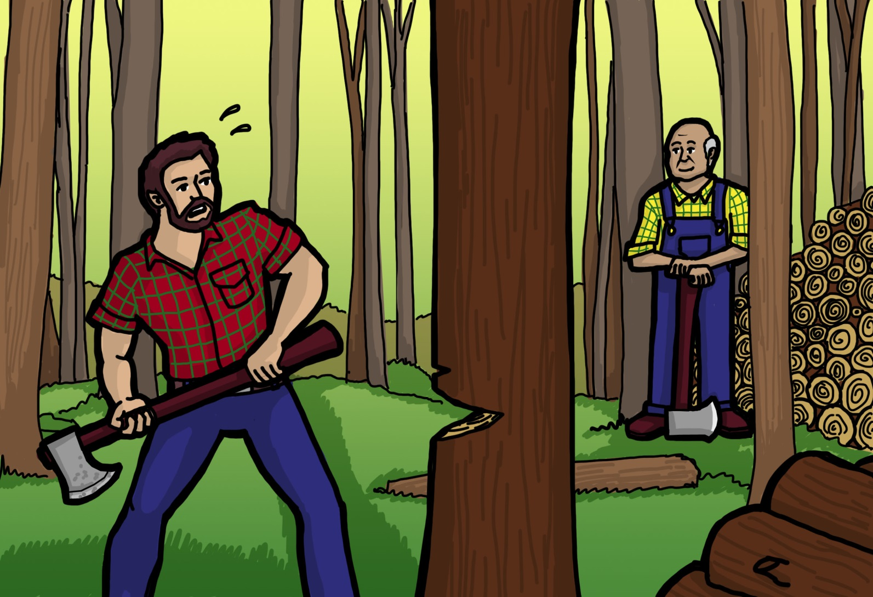
The Woodcutter Story

Slide 65

Thank you for your time!
Notes:
Questions?
Hand out evaluations

Slide 66
References
Abdallah, C.G. and Geha, P. (2017). Chronic Pain and Chronic Stress: Two Sides of the Same Coin? Chronic Stress, 1: 1- 10. DOI: 10.1177/2470547017704763
Branca, B., & Lake, A. E. (2004). Psychological & neurological integration in multidisciplinary pain management after TBI. Journal of Head Trauma Rehabilitation, 19, 40-57.
Bonin, R. (2015). Running from pain: mechanisms of exercise-mediated prevention of neuropathic pain. Pain,156(9), 1585–1586, http://dx.doi.org/10.1097/j.pain.0000000000000302.
Butler, D., Moseley, G. L. (2014). Explain pain (2nd Ed.). Australia: Noigroup Publications.
Hass-Cohen, N., Clyde Fidnlay, J. (2009). Pain, attachment, and meaning making: Report on an art therapy relational neuroscience assessment protocol. The arts in Psychotherapy, 36: 175-184.
Hassed, C. (2013). Mind-body therapies use in chronic pain management. Australian Family Physician, 42(3), 112-117.

Slide 67
Iezzi, T., Duckworth, M. P., Mercer, V., & Vuong, L. (2007). Chronic pain and head injury following motor vehicle collisions: A double whammy or different sides of a coin. Psychology, Health, and Medicine, 12, 197-212.
Lee, C., Crawford, C., & Schoomaker, E. (2014). Movement therapies for the self-management of chronic pain. Pain Medicine, 15, 40-53.
Mann, E. G., LeFort, S., & VanDenKerkhot, E. G. (2013). Self-management interventions for chronic pain. Pain Management, 3(3), 211-222.
Martelli, M. F., Zasler, N. D., Bneder, M. C., & Nicholson, K. (2004). Psychological, neuropsychological, and medical considerations in assessment and management of pain. Journal of Head Trauma Rehabilitation, 18, 10-28.
Miller, W. R., & Rollnick, S. (2013). Motivational interviewing: Preparing people for change (3rd ed.). New York: Guilford Press.
Molton, I., Jensen, M. P., Ehde, G. M., Carter, G. T., Kraft, G. & Cardenas, D. D. (2014). Coping With Chronic Pain Among Younger,Middle-Aged, and Older Adults Living With Neurological Injury and Disease. Journal of Aging and Health, 20 (8), 972-996.

Slide 68
Moseley, G. L., Nicholas, M. K., & Hodges, P. W. (2004). A randomized controlled trial of intensive neurophysiology education in chronic low back pain. The Clinical Journal of Pain, 20(5), 324-330.
Nash, V., Ponto, J., Townsend, C., Nelson, P. & Bretz, M. (2013). Cognitive Behavioural Therapy, self-efficacy, and depression in persons with chronic pain. Pain Management Nursing, 14(4), 236-243.
Newton-John, T. R. O., & Geddes, J. (2008). The non-specific effects of group-based cognitive–behavioural treatment of chronic pain. Chronic Illness, 4(3),199-208.
Pearson, N. (2009). Understanding pain for people in pain. Life Is Now Pain Care. Retrieved from http://www.lifeisnow.ca/hcp/links-resources/
Sommer, J. L., & Witkiewicz, P. M. (2004). The therapeutic challenges for dual diagnosis: TBI/SCI. Brain Injury, 18, 1297-1308.
Stanos, S., & Houle, T. T. (2006). Multidisciplinary and interdisciplinary management of chronic pain. Physical Medicine and Rehabilitation Clinics of North America, 17, 435-450.

Slide 69
Tyrer, S., & Lievesley, A. (2003). Pain following traumatic brain injury: Assessment and management. Neuropsychological rehabilitation, 13, 189-210.
Urban, M. O. & Gebhart, G. F. (1999). Central mechanisms in pain. Medical Clinics of North America, 83(3), 585-596.
Vlaeyen, J., W., Linton, S., J., (2000). Fear-avoidance and its consequences in chronic musculoskeletal pain: a state of the art. Pain, 8, 317-332.
Vowles, K., Sowden, Gl, Ashworth, J. (2014). A comprehensive examination of the model underlying Acceptance and Commitment Therapy for chronic pain. Behaviour Therapy, 45, 390-401.

