Slide 1
Improving primary care management of people with complex low back pain:
A feasibility study implementing the STarT Back model of care
Presentation to Ontario Physiotherapy Association InterACTION Conference, April 2018
by Kathleen Norman
Authors: Simon D French, David T Barber, Rachael Morkem, Jonathan C Hill, Graeme Leverette, Jordan Miller, Kathleen E Norman

Slide 2
Participants will be able to...
Understand the rationale for the use of the STarT Back tool in primary care as a component of management for patients with low back pain.
Discuss the results of a feasibility study to determine the barriers and facilitators to implementing the STarT Back stratified approach into Ontario primary care.

Slide 3
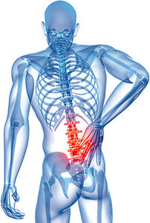
Background about Low Back Pain (LBP)
LBP is one of the most common problems seen in Canadian primary care settings.
Rapoport et al. Refining the measurement of the economic burden of chronic diseases in Canada. Chronic Dis Can 2004;25:13-21
The health and function of people experiencing back pain has deteriorated despite the escalating costs of health care devoted to this problem.
Mafi et al. Worsening trends in the management and treatment of back pain. JAMA Intern Med 2013;173:1573-81
Foster NE, Anema JR, Cherkin D, Chou R, Cohen SP, Gross DP, et al. Prevention and treatment of low back pain: evidence, challenges, and promising directions. The Lancet 2018; advance online.

Slide 4
Background about STarT Back
STarT Back model of care was developed in the United Kingdom by Jonathan Hill (PT, PhD) and colleagues
stratifies patients with back pain by their risk of ongoing pain and disability
Stratify

Slide 5
Structure of STarT Back
If Total score is 3 or less,
the patient’s category is LOW.
1. Has your back pain spread down your leg(s) at some time in the last 2 weeks?
No
Yes
0
1
2. Have you had pain in the shoulder or neck at some time in the last 2 weeks?
No
Yes
0
1
If Total score is 4 or more
3. Have you only walked short distances because of your back pain?
No
Yes
and subscore
is 3 or less,
0
1
4. In the last 2 weeks, have you dressed more slowly than usual because of back pain?
No
Yes
the patient’s category is MEDIUM.
0
1
5. Do you think it’s really not safe for a person with condition like yours to be physically active?
No
Yes
0
1
If Total score is 4 or more
6. Have worrying thoughts been going through your mind a lot of the time?
No
Yes
and subscore
is 4 or more,
0
1
7. Do you feel that your back pain is terrible and it’s never going to get any better?
No
Yes
the patient’s category is HIGH.
0
1
8. In general, have you stopped enjoying all the things you usually enjoy?
No
Yes
0
1
9. Overall, how bothersome has your back pain been in the last 2 weeks?
Not at all
Slightly
Moderately
Very much
Extremely
0
0
0
1
1

Slide 6
Matching treatment to risk
MEDIUM risk of persisting pain & disability
Advice, reassurance, and pain relief. Evidence based physical therapy
HIGH risk of persisting pain & disability
Standard PT Care Plus+ Comprehensive Biopsychosocial Treatment Address gaps in patient’s knowledge Correct possible misunderstandings Provide guidance on a variety of pain rehabilitation techniques including pacing, graded activity & exposure Specifically focus on the psychological prognostic indicators (catastrophizing, low mood, anxiety, and pain-related fear) with the adoption of simple CBTs
LOW risk of persisting pain & disability
Advice, reassurance, and pain relief. Avoid over treatment and investigation.

Slide 7
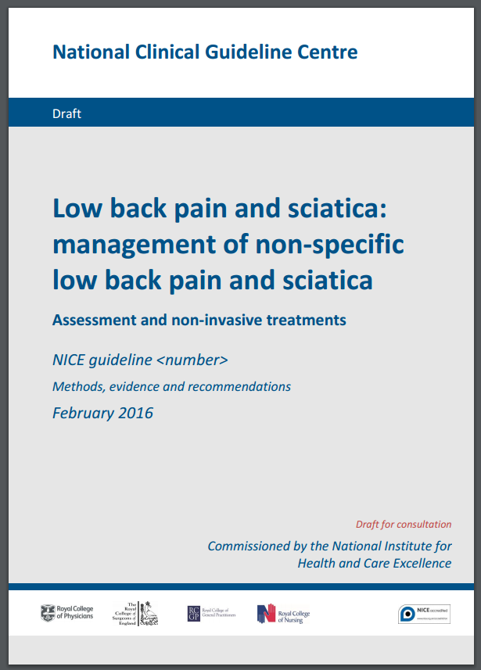
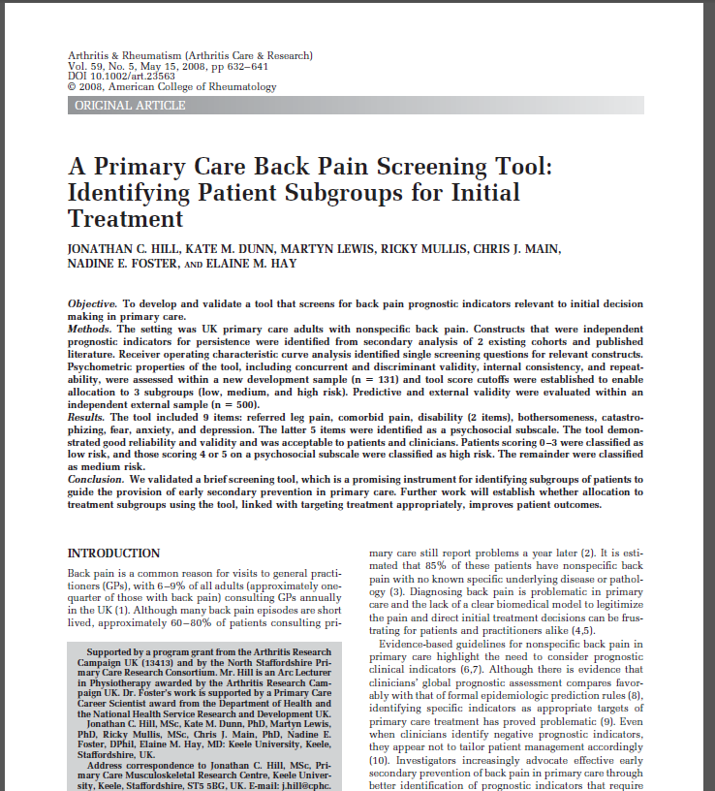
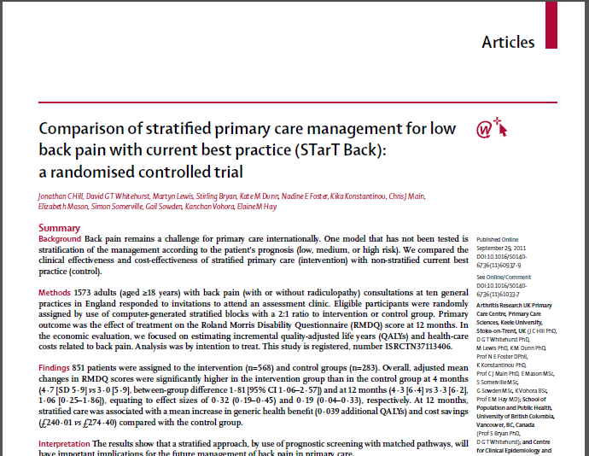
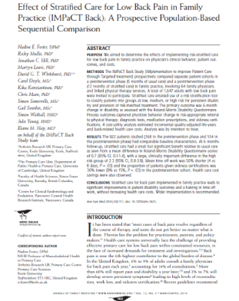
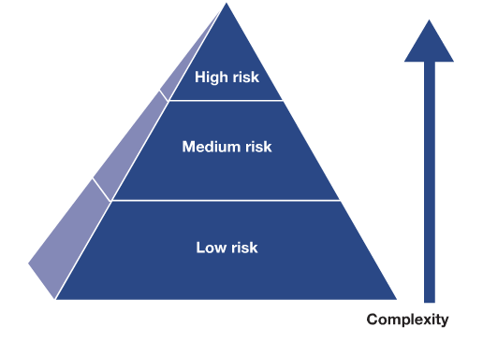
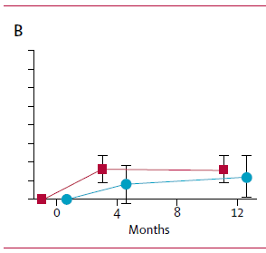
Evidence for STarT Back
Validated prognostic tool
Proof of principle RCT
Primary care implementation
& Qualitative research
NICE recommended
Hill et al 2008
(n=500)
Hill et al 2011
(n=851)
Foster et al 2014
(n=922)
Hill et al, A primary care back pain screening tool: identifying patient subgroups for initial treatment. Arthritis Rheum 2008;59:632-41
Hill et al, Comparison of stratified primary care management for low back pain with current best practice (STarT Back): a randomised controlled trial. Lancet 2011;378:1560-71
Foster et al, Effect of stratified care for low back pain in family practice (IMPaCT Back). Ann Fam Med 2014;12:102-11
Whitehurst et al. Implementing Stratified Primary Care Management for Low Back Pain: Cost-Utility Analysis Alongside a Prospective, Population-Based, Sequential Comparison Study. Spine 2015;40:405-14

Slide 8
Feasibility?
Implementation of the STarT Back model in the UK:
significantly improved patients’ functional outcomes
effect size 0.32 at 6 months
led to a 50% reduction in time off work due to back pain
reduced healthcare costs
≠

Slide 9
Ultimate aim/hope
Fully powered cluster randomized controlled trial

Slide 10
Purpose of current study
To determine the feasibility of undertaking a fully powered cluster randomized trial to evaluate the implementation of the STarT Back model of care into Ontario primary care
Can we successfully recruit physicians in a family health team (FHT)?
Can we successfully recruit patients through recruitment strategies at the FHT?
Can we get the STarT Back tool implemented in the FHT setting?
Will patients get the matched treatment appropriate to their risk category?
What do patients and physicians think of the STarT Back tool and the determination of appropriate treatment?
What proportion of recruited patients will complete all the questionnaires?

Slide 11
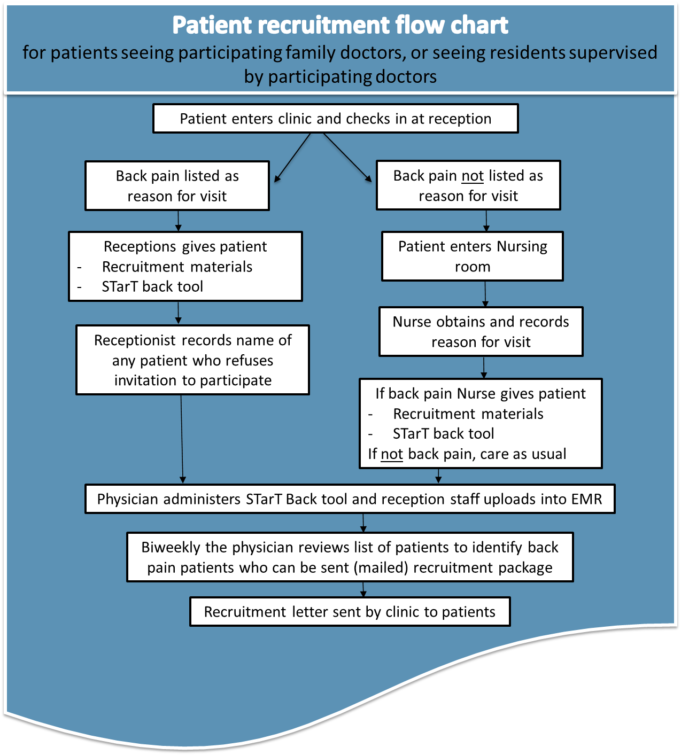
Recruitment
1 Academic Family Health Team
(22 physicians)
Physicians attended two 1-hour educational workshops on the management of low back pain using the STarT Back Tool.
14 physicians recruited (5 FTE)
Physician characteristics
Participating physicians (n) | 14
Age; mean (SD) | 49.8 (10.0)
Female / Male (%) | 71% / 29%
No. clinical hours/week; mean (SD) | 16.7 (6.3)

Slide 12
Recruitment
14 physicians recruited (5 FTE)
N = 21 of 26 answered questions about demographics
Age (mean ± SD, [min-max]) | 59 ± 16 [19-87]
Gender (N) | 14 F / 7 M
Employed? | 7 full-time Others no data
Any previous episodes of back pain? | Yes = 15
Length of current episode of LBP | > 12 months: 8 6-12 months: 3 3-6 months: 4 2-3 months: 2 Shorter: 3
WSIB, MVA or other coverage: | 1 of 21
Patient recruitment efforts underway for 6 months
n= 36 prospective patients recruited, almost all through the clinic reception staff
n = 10 excluded:
5: patient’s doctor not participating
4: excluded on clinical eligibility
1: refused
n= 26 included

Slide 13
Clinical features & STarT Back scores
from n = 21 of 26 who completed baseline questionnaire set
STarT Back based risk category | STarT Back score (0-9) | In the past week, on average, how intense was your pain? (0-10) | Roland-Morris Low Back Pain and Disability Questionnaire score (0-24)
Low (n = 2) | 2 or 3 | 4, 6 | 0, 6
Medium (n = 11) | 4, 5, or 6 | median 7, range 4 – 9 | median 8, range 6 – 21
High (n = 8) | 6, 7, 8, or 9 | median 9, range 5 – 10 | median 18, range 5 – 21

Slide 14
STarT Back scores @ baseline
Primary care visit to family health team
Low risk, n=9
Low risk, n=2
Follow-up self-report on baseline questionnaire
Medium risk, n=11
Medium risk, n=6
High risk, n=8
High risk, n=9
Did not do baseline survey, n=5
Tool not done, n=2

Slide 15
Referred to physiotherapist*
* to the best of our knowledge, the PT in our study
5 patients referred to physiotherapist
3 cancelled before coming to physiotherapy assessment:
1 “high” risk at FHT visit / “medium” on baseline questionnaire
1 “medium” risk at FHT visit / “high” on baseline questionnaire
cancelled, stating that s/he felt that seniors should get free therapy
1 “low” risk at FHT visit [no data on baseline questionnaire]
1 initiated assessment with a different PT at the same clinic
? before referral by physician? / was “high” risk in both STarT Back iterations
1 came to PT assessment & 2 follow-up appointments
“high” risk on both STarT Back iterations, paid out-of-pocket

Slide 16
Patients’ completion of questionnaires
Among 26 patients with valid consent & eligible
21 initiated* survey of baseline questionnaires
23 initiated* survey of 4-week questionnaires
22 initiated* survey of 6-month questionnaires
A small number needed to be walked through it over the telephone.
Almost everyone who initiated a survey also finished it:
Completion times (mm:ss) | Baseline | 4-week | 6-month
Mean | 18:54 | 18:10 | 19:38
[min – max] excluding outliers | [9:57 – 31:18] | [3:28 – 33:22] | [7:11 – 41:14]

Slide 17
Themes from patient interviews
Feedback on the STarT Back Tool:
Most patients remember completing the tool, although some needed prompting.
Patients had no problems with any of the STarT Back tool items.
Imaging:
Patients often raised the topic of visiting their physician due to wanting to have imaging arranged.
Discussion of STarT Back results between physicians and patients:
With rare exception, physicians did not discuss the STarT Back results with their patients.

Slide 18
Themes from patient interviews
Understanding and agreement with the STarT Back risk categorization:
Understanding of what the risk categorization meant was highly variable.
Some, but not all, patients in high or medium risk categories agreed with their risk categorization, and patients in low risk category generally didn’t agree.
Matched treatments:
The treatment patients were recommended, and subsequently received, was typically not consistent with their STarT Back risk category:
i.e., low risk patients were referred to physiotherapy and medium/high risk patients were not referred.
Capacity to pay for allied healthcare services:
Capacity to pay was often a barrier to seeking those services.

Slide 19
Themes from physician interviews
Theoretical Domains Framework
Michie et al., Quality and Safety in Health Care, 2005.
Domains in TDF
Knowledge
Skills
Professional role and identity
Beliefs about capabilities
Beliefs about consequences
Motivation and goals
Memory, attention and decision processes
Environmental context and resources
Social influences
Emotion
Action plans
Nature of the behaviour

Slide 20
Themes from physician interviews
Beliefs about consequences
re: using the STarT Back tool
Facilitators
Barriers
Physicians found the STarT Back tool helpful, concept of stratification fits with physician’s clinical decision making.
The tool was helpful for identifying psychosocial factors that physician might not otherwise have explored.
Tool results do not necessarily change what physician already knew.
Reluctance to use the tool in patients with longstanding LBP and physician already had relationship with them.
Concern about labelling “high risk” especially when patient had no access to matched treatment.

Slide 21
Themes from physician interviews
Beliefs about consequences
re: acting on the tool’s recommendations
Facilitators
Barriers
Physicians generally supportive of referral to PT for patients with low back pain.
Patients in low risk category may want PT anyway.
Patients in medium or high risk often do not have financial access to PT.
Physicians unsure about what treatment would be provided by PT for high risk patients.
Physicians unsure about how people responded who received PT treatment.

Slide 22
Themes from physician interviews
Environmental context and resources
Facilitators
Barriers
Physicians grateful for resources:
1-page info sheet for patients
the ‘matched treatment’ for low risk patients but available to all
PT student designed!
information cards for local OHIP EOC clinics
Availability of PT
Only 1 PT in the region trained for providing treatment for patients in high risk category.
Absence of PT on-site at the FHT.
Physicians didn’t see it as their role to ask the patient to fill out the STarT Back tool.
Tool was not implemented in the electronic medical record.

Slide 23
Reflections / Conclusions [1]
We can recruit physicians...
engagement? buy-in?
We can recruit [a small number of] patients...
using mostly the strategy of protocol with clinic reception staff
most of patients recruited were not low risk for persistent pain and disability
Patients who are recruited will mostly complete all questionnaires
even if it takes up to 30 minutes each time, and they may need multiple reminders to get started
STarT Back Tool is easy to use... but
difficult to get attention / buy-in from physicians / patients that the score/risk is relevant
uncertain why “baseline” score was not very stable

Slide 24
Reflections / Conclusions [2]
Many patients and physicians in this FHT considered capacity to pay for physiotherapy as a barrier
consistent with concerns raised by the physicians in the initial workshops
reinforced as the most important barrier in physician interviews
Physicians are supportive that STarT Back tool is useful.
It makes the psychosocial component of LBP more overt.
However, there are many system barriers to implementing matched treatments.

Slide 25
Acknowledgements
FUNDING
PARTICIPANTS
Physiotherapy Foundation of Canada
Physicians and staff of the Queen’s Family Health Team (QFHT)
Participants through being patients with low back pain at the QFHT
Kim Wolny Research Grant
Support for qualitative analysis
Research Leaders Opportunities Fund
Catherine Donnelly
Amanda Mofina
Kevin Varette

