Slide 1


Performance patterns among internationally educated physiotherapists during clinical education in a bridging program.
¹Kalu ME, ²Switzer-McIntyre S, ²Quesnel M, ³Donnelly C & ³Norman KE
¹School of Rehabilitation Science, McMaster University, Hamilton, ON.
²Department of Physical Therapy, University of Toronto, Toronto, ON
³School of Rehabilitation Therapy, Queen’s University, Kingston, ON
Presented by Michael Kalu @ the OPA InterACTION, 2018

Slide 2
Presentation outline
Learning Objectives
Background
My research
Methods
Results
Discussion
Research Implications

Slide 3
Learning Objectives
After attending this session you should be able to;
  Describe patterns of performance of internationally educated physical therapists during their clinical education experiences in a bridging program.
  List the areas of strength and areas for improvement of the internationally educated physical therapists based on the comments entered in the comment sections of the Canadian Physiotherapy Assessment of Clinical Performance (ACP) by the clinical instructors during learners’ clinical placements.

Slide 4
Background
In 2016, College of Physiotherapists of Ontario reported that 23% of the PT workforce is internationally educated (~ 1,950 PTs).
In 2015 (most recent data), the Canadian Alliance of Physiotherapy Regulators reported 754 internationally educated physiotherapist (IEPT) applied for credentialing.

Slide 5
Who is an Internationally educated physiotherapist
Any individual including a Canadian Citizen that graduated from a university degree program in physiotherapy outside of Canada.
Canadian Alliance of Physiotherapy Regulators, 2018

Slide 6
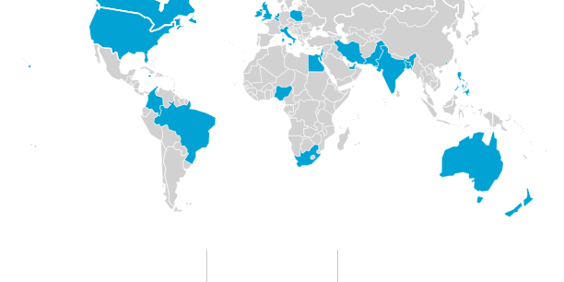
Country Profiles – Top Source Countries
Canada
UK, Ireland, Netherland, Belgium, Italy, Poland
USA
Egypt
Jamaica
Iran, UAE, India, Pakistan
& Bangladesh
Philippines
Colombia
Nigeria
Brazil
Australia
South Africa
New Zealand
Canadian Alliance of Physiotherapy Regulators, 2018
http://www.alliancept.org/becoming-credentialled/source-country-profiles/

Slide 7
Top 10 Source Countries 2015
Country(F)
India (430)
UK (65)
Philippines (56)
Australia (49)
USA (25)
Nigeria (16)
Iran (14)
Pakistan (13)
Brazil (13)
Egypt (12)
Canadian Alliance of Physiotherapy Regulators, 2015

Slide 8
background
To practice as a registered physiotherapist in Canada, it is MANDATORY to pass both the written and clinical components of the professional competency exam.
IEPTs’ Physiotherapy Competency Examination success rates are 50% and 59% on the written and clinical exams
Canadian trained PTs’ Physiotherapy Competency Examination success
rates are 94% and 92% on written and clinical exams
V
(Canadian Alliance of Physiotherapy Regulators , 2018)

Slide 9
Ontario Internationally Educated Physical therapy Bridging (OIEPB) Program
Educational program
  Clinical and course base materials
  Stated Goal:
    " to enhance the internationally educated physiotherapist’s (IEPTs) professional and clinical competencies to qualify for practice as an autonomous practitioner within the Canadian health care system.”
(OIEBP, 2018)

Slide 10
The Comprehensive Bridging program
PT Framework & Consolidation of Fundamentals
Clinical Internship 1
Integrated PT Practice
Clinical Internship II
TERM ONE
TERM TWO
(OIEBP, 2018)

Slide 11
Success story
IEPTs’ Physiotherapy Competency Examination success rates are 50% and 59% on the written and clinical exams
Canadian trained PTs’ Physiotherapy Competency Examination success
rates are 94% and 92% on written and clinical exams
V
Still room for improvement
IEPTS that pass through the OIEPB program success rates are 80% and 82% on the written and clinical exams
(OIEBP, 2018)

Slide 12
Research Questions
What are the patterns of ACP scores among learners in the 4th and 5th cohorts of the OIEPB program?
What are the areas of strength and areas requiring improvement in clinical performance by learners in the 3rd, 4th and 5th cohorts of the OIEPB program?
Notes:
The 3rd, 4th and 5th cohort are the cohorts we had ACP data on.

Slide 13
Research Process
Secondary Data Analysis of the Canadian Physiotherapy Assessment of Clinical Performance
Numeric scoring system
Open ended comment section
Developed by Mori et al. (2016)

Slide 14
About the OIEPB Program and its learners
We evaluated 3rd, 4th and 5th cohort (n=101)
Learners complete two internships of 4 weeks duration and in areas requiring greatest professional development
Demographics:
  Top Source countries: 45% of the learners from India (45), and 20 % from Philippines.
  Gender: 70% Female
  68% had experience in Canadian health care system as a support personnel or PT assistant.
  70% of the learners have not practiced physiotherapy for five years or less
  62% of learners graduated between 2001-2010.
Notes:
The 3rd, 4th and 5th cohort are the cohorts we had ACP data on.

Slide 15
ACP Scoring
What are the patterns of ACP scores among learners in 4th and 5th cohorts of the OIEPB program?
Sample size:
n = 27 (4th cohort)
+ n = 35 (5th cohort)
= total n = 62 learners
Notes:
Only the ACP scores of the learners in the 4th and 5th cohort were included in the present study because they are the only OIEPB cohorts that used the final version of the ACP rating system for assigning scores.

Slide 16
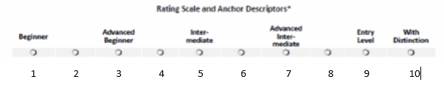
ACP Scores
Roles (items)
Expert (8)
Communicator (3)
Collaborator (2)
Manager (3)
Advocate (1)
Scholarly Practitioner (1)
Professional (3)
The Clinical preceptors assign scores on the ACP rating scale to represent the performance of each learner both at mid term and final term in both clinical internships
Expert role has three focus
  Assessment- 2 items
  Analysis- 3 items
  Intervention- 3 items

Slide 17
Data analysis
  Item level description
Individual Learners’ ACP mean score
  ACP Mean Scores
Categories of ACP Score Patterns
high performance throughout
highly improved performance within and across internships
moderately improved performance within and across internships
moderate performance with low change
low performance throughout.
  % and counts for demographic information
Notes:
To be in category 1, a learner must have a score of 7 (advanced intermediate performance) or higher in 12 or more of the ACP items at all points of both internships and also must have a score of 9 (entry level performance) or 10 in 17 or more of the final point ratings in their best internship. To be in category 2, a learner must have shown an obvious improvement in at least 70% of the items of the ACP in at least one internship; this improvement was typically from a low or moderate score at midpoint to a score of 9 (entry level performance) at final point. To be in category 3, a learner must have shown an obvious improvement similar to what was described above for category 2, except that the final point score was at least 7 (advanced intermediate) rather than 9. To be in category 4, a learner must have shown an improvement in at least 70% of the items of the ACP, but did not attain enough improvement to be in category 3; most of the final term ratings were 5 or 6. To be in category 5, a learner must have had most of the items in the ACP rated 5 and below.

Slide 18
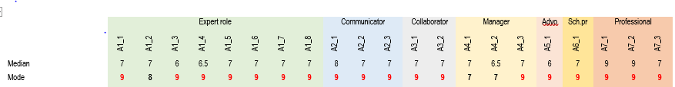
Findings- Item level description
Frequency counts for the ACP scores at the final point of the internships
Most of the learners have entry level entry score in 18 out of the 21 items
  Most IEPTs did not reach entry level practice in the following items:
  collects assessment data and physiotherapy practice (Expert role)
  manages individual practice effectively (Manager role)
  supervises support personnel (Manager role)

Slide 19
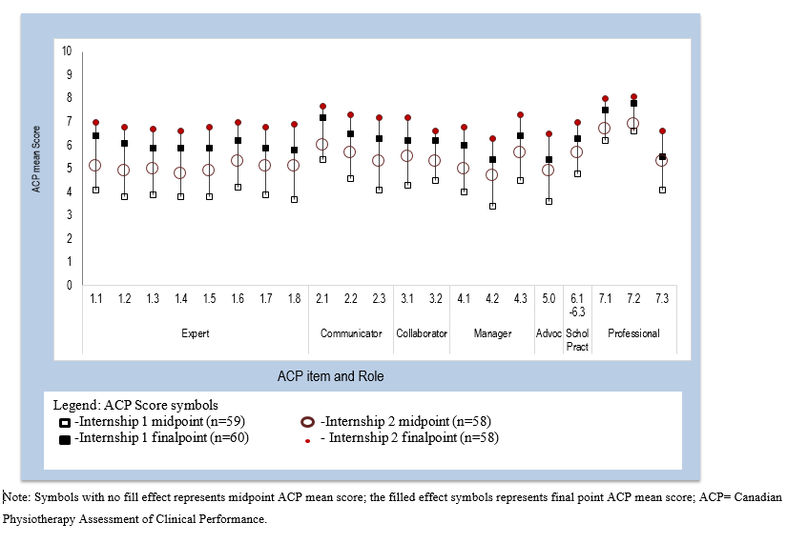
ACP MEAN SCores
conducts self within legal / ethical requirements
develops… professional relationships through effective communication
respects individuality and autonomy of the client

Slide 20
Results – individual pattern categorisation
category 1= high performance throughout
category 2 = highly improved
category 3 = moderately improved
category 4 = moderate throughout
category 5 = low performance

Slide 21
Category 1- High performance throughout
Clinical internship II
final rating
midterm
Clinical internship I
final rating
midterm
n=5 (8.8%)
Notes:
To be in category 1, a learner must have a score of 7 (advanced intermediate performance) or higher in 12 or more of the ACP items at all points of
both internships and also must have a score of 9 (entry level performance) or 10 in 17 or more of 58
the final point ratings in their best internship

Slide 22
Category 2-highly improved
Clinical internship II
final rating
midterm
Clinical internship I
final rating
midterm
n=18 (31.6%)
Notes:
To be in category 2, a learner must have shown an obvious improvement in at least 70% of the items of the ACP in at least one internship; this improvement was typically from a low or moderate score at midpoint to a score of 9 (entry level performance) at final point.

Slide 23
Category 3- Moderately improved
Clinical internship II
final rating
midterm
Clinical internship I
final rating
midterm
n= 25 (43.9%)
Notes:
To be in category 3, a learner must have shown an obvious improvement similar to what was described above for category 2, except that the final point score was at least 7 (advanced intermediate) rather than 9.

Slide 24
Category 4- Moderate throughout
Clinical internship II
final rating
midterm
Clinical internship I
final rating
midterm
n=7 (12.3%)
Notes:
To be in category 4, a learner must have shown an improvement in at least 70% of the items of the ACP, but did not attain enough improvement to be in category 3; most of the final term ratings were 5 or 6.

Slide 25
Category 5 -low performance
Clinical internship II
final rating
midterm
Clinical internship I
final rating
midterm
n=2 (3.5%)
Notes:
To be in category 5, a learner must have had most of the items in the ACP rated 5 and below.

Slide 26
ACP comment section
What are the areas of strength and areas requiring improvement in clinical performance by learners in the OIEPB program?

Slide 27
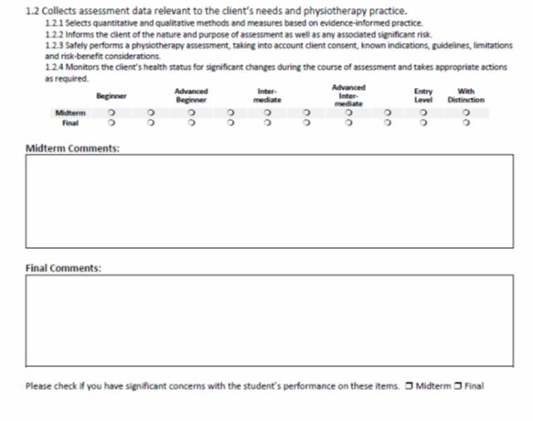
9 comment box
The written comments in a clinical performance assessment tools may detect specific and/or latent learners behaviors which a quantitative data (numeric scoring) may not detect.
We considered written comments in both the mid term and final term of each role

Slide 28
Data Sets
n=19 data sets not available during data analysis
Clinical internship I
Clinical internship II
101 learners
Midterm
Midterm
Expected “404 ACP data sets for analysis”
Final term
Final term
Cohorts
3rd (n=39)
4th (n=27)
5th (n=35)
Four ACP data sets (2 sets on each of 2 forms) for each learner
n=385 data sets were analysed

Slide 29
Data analysis
A Hybrid content analysis
  Direct content* conventional
  Examples:
  Statement about an area for improvement
  “needs cueing to look at the client’s facial expression during assessment and needs cueing for precautions and contraindication during treatment”
  Statement about a strength
  “Great development of writing analysis statements esp. for initial assessment documentation. They are comprehensive and concise”
Micro level analysis
Roles: (sub-categories)
Expert
Communicator
Collaborator
Manager
Advocate
Scholarly practitioner
Professional
Macro level analysis
Central categories
IEPTS clinical Skills
Figure 1- Analysis level

Slide 30
Data analysis / Results Summary
DATA
within ROLES
merging across ROLES
CENTRAL THEMES
statement
sub-category
(n=22)
category
(n=7)
statement
2 central themes
statement
sub-category
(n=14)
category
(n=4)
statement
Subsequently:
7 categories
4 categories
Central theme: Professional Practice - 3 and 2
Central theme: Professional Conduct - 4 and 2

Slide 31
Results- Within Role subcategories
Expert Role
Area of strength:
Exercise prescription
Subjective history taking
Patient handling and therapist body mechanics
Area for improvement
Confidence issues
Objective assessment
Poor logical reasoning
Cueing to set SMART goals
“Struggles to objectively assess patient but performs interventions such as exercise prescription with FITT, and basic transfers” [C1-9]
“thorough history and performs assessment in a safe way to both self and client and obtains consent”- [C2-15]

Slide 32
Result- With Roles subcategories
Communicator Role
Area of strength:
Rapport with clients
Patient’s confidentiality
Area for improvement
Time management in documentation
Confidence issues
Confusing commands
Communication tone
Poor non-verbal communication skills
*No clear or concise SOAP documentation
“….but he is very good with clients - one client even told me that James has a good way around the clients” [C1-4 ]
“A little unsure when it is appropriate to communication, will need to contribute in the IP rounds as appropriate....” [C2-24].

Slide 33
Results: within Roles Subcategory
Collaborator Role
Area of strength:
Respect for team members
Team member’s role
Area For improvement:
Poor communication
Confidence issues
“He was able to understand his role as a physiotherapist”…. [C2-4],
“You need to understand the tone of your language and be able to learn some of the languages suitable for Canadian culture and focusing more on specific language for each age group” [CI- 16].

Slide 34
Results- Within Role subcategories
Manager Role
Area of strength:
Manages Caseload
Area for improvement
*Time management
Patient Safety
Confidence issues
Canadian Healthcare system
PTA/OTA use
“Manages case load well. Able to attend 1 hour patient care rounds, see 7 patients in a day including (new assessment, follow ups and complex patients)” [C2-15]
“She takes much time in assessing, treating and documenting………This is a fast paced setting……”[CI-4]

Slide 35
Result- within role subcategories
Advocate Role
Area of strength:
Education
Health Promotion
Area for improvement:
Community Services
Adjunct therapy
“It is understandable that she is not aware of some of the community services available for patients, but I commend that you always ask questions to learn about them……..” [CI-8]
“He often educates the patients about self management” [C1-2]

Slide 36
Result- With Roles Subcategories
Scholarly Practitioner Role
Area of strength:
Self reflective practice
Area for improvement:
Problem solving skills
“she has been able to self reflect and recognize that her background, experiences and perspective impacts her assessment and decision making” [C1-13]
“She need guidelines to critically appraise literature and understand approaches to using evidence to solve clinical problems” [C2-14]

Slide 37
Result-With roles Subcategories
Professional Role
Area of strength:
Respect for clients or/and team members
Maintain clients’ confidentiality
Sensitive to patients’ concerns
Area for improvement:
Communication
Scope of physiotherapy practice
…always presents herself in a professional manner with patients and staff. She is always respectful of pt’s opinion (eg. Mr.P) while providing pts with the necessary education to optimize safety”… [CI-13]
”Some procedures are strange to him and he struggles to communicate with other team members”[C2-11]

Slide 38
Descriptive synthesis of the competencies & deficiencies for IEPTS
Canadian health care system
Professional Practice
Objective assessment
Professional Practice
Subjective assessment
Professional Conduct
Professional Conduct
Communication
Treatment delivery
Patient confidentiality
Inter-professional Respect
Setting of SMART goals
Clinical reasoning
Confidence
Time management
Patient safety
Complex patients
Notes:
The subcategories form the categories, which are the box in by the sides of these diagrams, with the red indicating categories explaining areas for improvement among the IEPTs and blue indicate area of strength. At the end of this, The two central theme that emerged from the analysis were professional practice and professional conduct.
The professional practice are skills on the Physiotherapy Competency Profiles that is heavily characterized by the expert role descriptors. These are performing skills of the therapist towards the clients during everyday practice.
Professional conducts are complementary actions required to ensure that professional practice skills are efficient and patient centered. Majority of these professional conducts are descriptors of roles in the ACP other than the “experts” role.

Slide 39
Significance / Further research
(A): Follow OIEPB graduates into practice to understand if areas for improvement are fully addressed or how they affect employment / practice
(B): Feeding back into the OIEPB program to strengthen its ability to bridge learners with regard to areas for improvement
(C): See the extent to which IE healthcare professionals of other professions have similar patterns of strengths and areas for improvement, possible collaborations among bridging programs
(D): Explore in more detail if clinical setting has an influence in the scoring patterns and areas of strength and areas for improvement.
A
C
D
B

Slide 40
Summary about scores
Most of the 61 learners' scores indicated entry-level performance for 18 of 21 ACP items at the end of both internships.
Most IEPTs (84%) either had high scores throughout or had improvements from lower scores to at least 'advanced intermediate' performance level at the end of the second internship.

Slide 41
Summary about comments
Professional conduct and professional practice were the two major themes.
  Areas of strength including subjective assessment, treatment delivery, patient confidentiality and respect of interprofessional team members.
  Areas requiring improvement including objective assessment, setting of SMART goals, clinical reasoning, communication, confidence, time management and patient safety.

Slide 42
Trustworthiness / Limitations
Trustworthiness
credibility,
transferability,
dependability,
confirmability
Limitation
member checking with clinical instructors
two or more coders involved throughout the coding process
the missing value issue

Slide 43

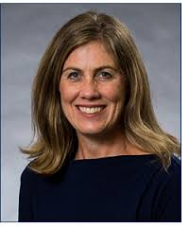



Acknowledgments
Dr Kathleen Norman
Dr Catherine Donnelly
Dr Sharon Switzer-Mclyntre
Martine Quesnel
Ontario Internationally Educated Physical Therapy Bridging Program

Slide 44


Slide 45
References
Canadian Alliance of Physiotherapy Regulators (2015). Annual Report 2015: Innovation and Excellence stepping into the future. Retrieved., March 23rd 2018, fromhttp://www.alliancept.org/wp-content/uploads/2016/06/CAPR-Annual-Report-2015.pdf
Government of Canada (2015). Facts and figures 2013-Immigration overview: Permanent Residents/2015 Canada-permanent residents by labour market intention, occupation and skill level. Canada. (Online). Available from http://www.cic.gc.ca/english/resources/statistics/facts2014/permanent/22.asp (accessed on 10 October 2015).
Greig, A., Dawes, D., Murphy, S., Parker, G., and Loveridge, B. (2013) Program evaluation of a model to integrate internationally educated health professionals into clinical practice. BMC Medical Education, 13: 140
Hsieh, H and Shannon, C (2005) Three Approaches to Qualitative Content Analysis. Qualitative Health Research, 15(9) : 1277-1288.
Mori, B., Brooks, D., Norman, K., Herold, J and Beaton, D (2015) Development of the Canadian Physiotherapy Assessment of Clinical Performance: a new tool to assess physiotherapy students’ performance in clinical education. Physiotherapy Canada 67(3); 281–289. doi:10.3138/ptc.2014-29E

Slide 46
References continue
Mori, B., Brooks, D., Norman, K., Herold, J and Beaton, D (2016a) Canadian Physiotherapy Assessment of Clinical Performance: face and content validity. Physiotherapy Canada. 68(1):64–72. http://dx.doi.org/10.3138/ ptc.2015-35E
Mori, B., Norman, K., Brooks, D., Herold, J and Beaton, D. (2016b) Evidence of Reliability, Validity, and Practicality for the Canadian Physiotherapy Assessment of Clinical Performance. Physiotherapy Canada. 68 (2): 156-169.
National Physiotherapy Advisory Group (NPAG) (2009) Essential Competency Profile for Physiotherapists in Canada. Canadian Alliance of Physiotherapy Regulators: Toronto.
Norman, K (2014) Ontario Internationally Educated Physiotherapy Bridging program. Program Evaluation Report, Ontario. The University of Toronto.
Ontario Internationally Educated Physical Therapy Bridging (OIEPB) Program. Ontario Internationally Educated Physical Therapy Bridging (OIEPB) Program. Physical Therapy Home Page (University of Toronto) (2016) [Internet]. Available from: http://www.physicaltherapy.utoronto.ca/iept/ [Accessed on 2016 August 26]

Slide 47
References continue
Ontario Internationally Educated Physical Therapy Bridging Program (2018) : Comprehensive Program. (Online). Availlable from https://oiepb.utoronto.ca/comprehensive-program/ ( accessed on 12th March, 2018)
Ontario Internationally Educated Physical Therapy Bridging Program (2018) : Program Description. (Online). Availlable from https://oiepb.utoronto.ca/comprehensive-program/program-map/ ( accessed on 12th March, 2018)
Roach, K., Frost, J., Francis, N., Giles, S., Nordrum, J and Delitto, A (2012) Validation of the Revised Physical Therapist Clinical Performance Instrument (PT CPI): Version 2006. Physical Therapy 92(3):416-428.
Switzer-Mclntyre, S., Bonnyman, A and Quesnel, M (2015) Bridging for success; lessons learned by the Ontario Internationally Educated Physiotherapy Bridging Program. WCPT Congress 2015, Singapore, 1-4 May 2015. Physiotherapy, 101 (1): eS1238- eS1642.

